Slide 1





EPCI European Passive Components Institute
EPCI Gold Members
COTS Automotive Capacitors Procurement and Evaluation Case Study for SME Space Hardware Manufacturer
EPCI – ESA Case Study
CMSE, 22nd April 2021
By Tomas Zednicek Ph.D.
EPCI European Passive Components Institute
www.passive-components.eu

Slide 2
OUTLINE
Introduction
Purpose of the Study
Tantalum and Ceramic Capacitor Technologies
Automotive Requirements & Delta Analysis
Procurement & Purchasing
PN Selection, Search & Documentation
Communication with Distributors & Manufacturers
Ordering & Deliverable
Capacitor Ageing Test Evaluation
Ageing Test
Automotive vs COTS level Comparison

Slide 3





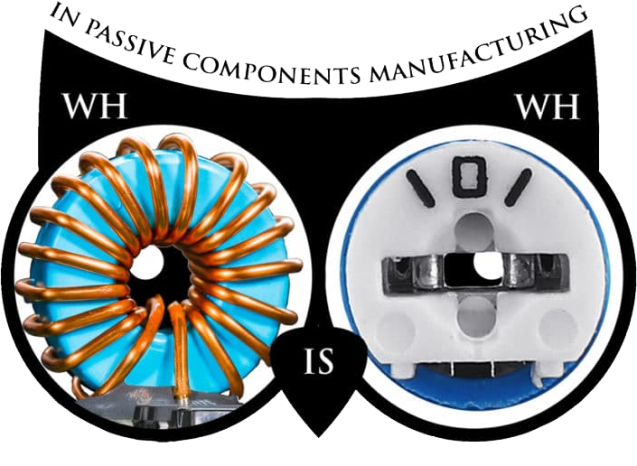




Introduction – EPCI
EPCI European Passive Components Institute
be active with passives !
One of few educational and information resources dedicated solely to passive components
Established 2015, Elektra 2016 Finalist
EPCI among the top 15 best rated global component blogs since 2018
WHO is WHO in Passives
free online database of global passive
components manufacturers & suppliers
www.epci-academy.com
www.passive-components.eu | Passive Components Educational & Information Blog
EPCI Academy
from student level to professional certified online e-learning courses on passive components
2021 passive-components.eu web Mar 2021 profile:
Active visitors: >40K/month
Google Search views: 1.8 million views /month
Google Search clicks: 35 thousands clicks / month
Newsletter: > 650 subscribers related to passive components
Top countries: USA, India, Germany, UK, Canada, France, Sweden
Europe 30%
Americas 32%
Asia 31%

Slide 4

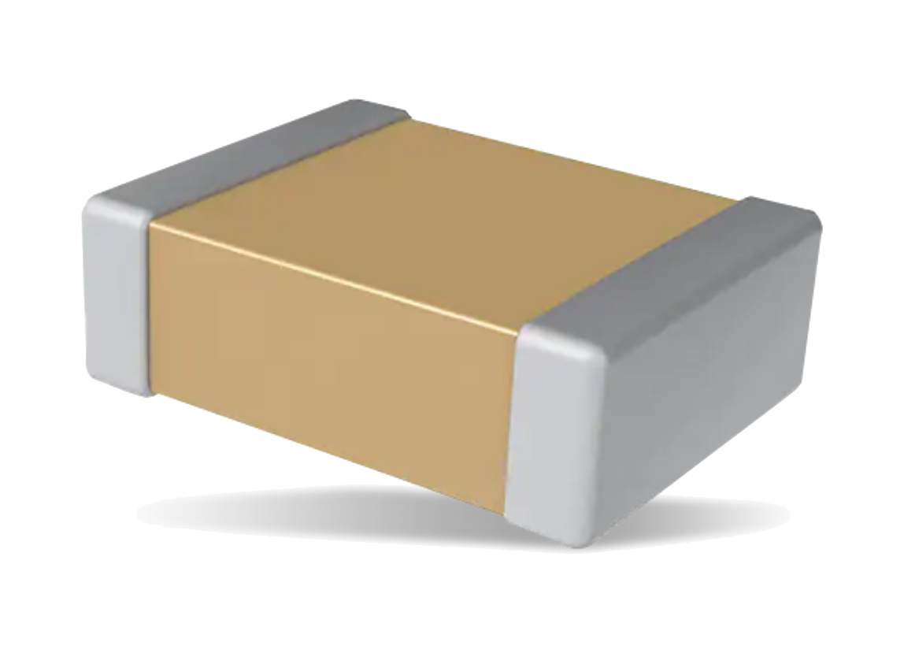
Introduction
Purpose of the Study
Simulate Procurement of Automotive & COTS Capacitors for Space Projects by a SME Space Hardware Manufacturer
Monitor the Procurement Process & Communication on Tantalum and MLCC Ceramic Capacitors
Technical, Administrative and Document Support
Compare Automotive AEC-Q200 and COTS+ Procurement Process
Evaluate Tantalum & MLCC AEC-Q200 vs COTS+ Performance under 168h Ageing Test

Slide 5
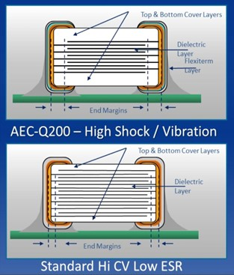
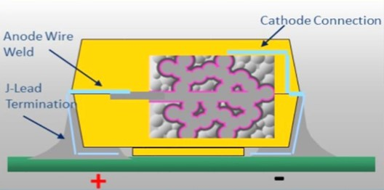
Introduction – Tantalum & MLCC Capacitor Technologies
Tantalum Capacitors
MLCC Ceramic Capacitors
MLCC construction comparison AEC-Q200 vs standard grade; source: AVX
Tantalum Capacitor Construction – common structure for AEC-Q200 and standard grade; source: AVX
Major construction differences Auto/COTS vs Standard grade
Design parameters:
  high end margins
  less number of layers
  thicker dielectric
  flexible terminations
Significantly lower CV
No major construction differences Auto/COTS vs Standard grade
Auto design may have more conservative CV & FV ratio

Slide 6
Introduction – Auto AEC-Q200 Requirements & Availability
AEC-Q200 Revision D minimum requirements for qualification of passive electrical devices.
In base document the general requirements includes:
• Qualification and Requalification conditions
• Qualification Tests
• Qualification Sample Size Requirements
Specific to tantalum and ceramic capacitors:
• Methods Referenced Tantalum and Ceramic Capacitors
• Ceramic/Tantalum Process Change Qualification guidelines for the Selected Test
• Acceptance Criteria for Ceramic COG, X7R and X5R SMD Capacitors
• Acceptance Criteria for Tantalum and Niobium Oxide Capacitors
Note: AEC-Q200 define qualification test requirements only. Quality system documents such as PPAP/APQP are now part of the latest IATF 16949 quality system certification.
In the event of conflict in the AEC-Q200 requirements, the product can be supplied following order of precedence applies:
1. The purchase order
2. The user’s individual device specification
3. The AEC-Q200 document
4. The AEC-Q200 family other specific documents
5. The supplier's data sheet
Observation
AEC-Q200 data-package is not necessary publicly available document. It shall be available upon request; however, manufacturer has the right to request confidentiality agreement prior providing these documents.
The data, test method, calculations, and internal criteria need not be demonstrated or performed on the qualification of every new device but should be available to the user upon request.
Note: This information may be subject to a confidentiality agreement, since it contains proprietary information of the supplier.

Slide 7
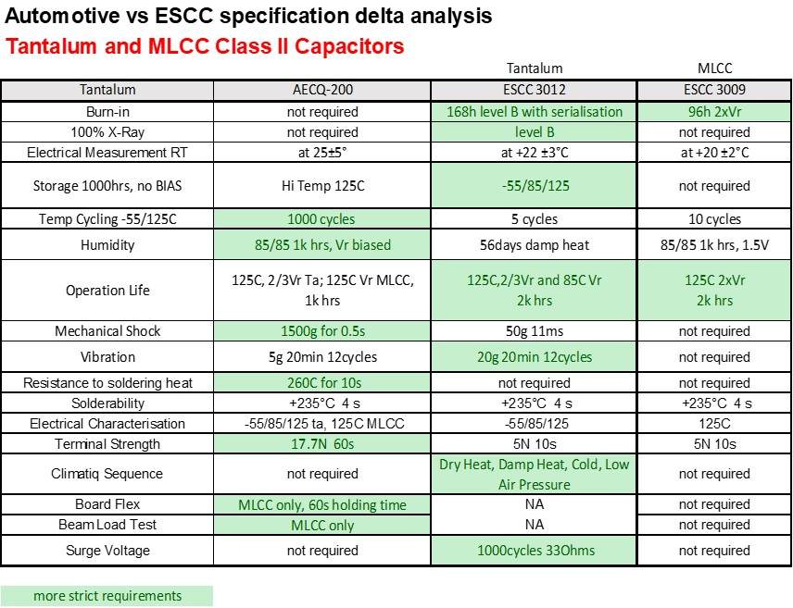
Introduction – AEC-Q200 vs ESA ESCC Space Delta Analysis
Mandatory Burn-In

Slide 8
Procurement & Purchasing
Passive Component Manufacturers
Three passive component manufacturers were contacted by online email support link and questioned:
a] 100unit order for tantalum and ceramic automotive grade capacitors
b] technical question about automotive parts reliability
The response from manufacturers on 100unit online order can vary by individual person handling the request. Feedback received sorted from the most often:
  “for non-modular quantities please check our distributors contact list, in case of sample request please fill up this form”
  “you can request such quantity as samples for your evaluation board, please see the link here.”
  “no response” within two weeks after the online/email request
Handling of technical question:
  “we have forwarded your question to our colleagues that will answer to you in follow up email”
  “for technical questions please check our online knowledge library with most of the common answers”
Observations
Small volume of parts ~100 units is possible to get as a “sample” free of charge upon justification of “high” business opportunity or “interesting opportunity”. The “interesting opportunity” may include also space applications. Non-modular Qty request – ask Disty
In general, it does not look to be a good idea to combine request for purchasing and technical question in one email. There are different group of support people handling such requests and co-ordination is sometimes fuzzy on side of manufacturers.
Some manufacturers however are introducing direct contact email to their FAEs and experts online for technical questions. New trend is to have even a live chat with their experts. This seems to be a better way for getting direct, high quality response to technical questions then contacting a local manufacturer representative or writing an email to their general support email address.

Slide 9
Procurement & Purchasing
Distributors
Four DISTRIBUTORS were contacted by online email support link and questioned:
a] 100unit order for tantalum and ceramic automotive grade capacitors
b] technical question about automotive parts reliability
The contacted distributors types under the survey:
global “universal” distributor of wide range of electronic active and passive components
global “specialist” distributor focusing passive components
“catalogue” parts distributor
COTS up-screening testhouse
Observations
No issue to order 100units of non-modular samples from all distributors
Some distributors request “extra fee” in range of 5 EUR for non-modular quantities (tape cut)
The tape cut by distributor may be link with other issue for MSL sensitive parts
Automotive AEC-Q200 parts in the distributor online stocks are clearly identified and traceable
AEC-Q200 datapackage is a legitimate request even for 100units. However, it may not be available with the product, also documentation control can be an issue. No one in the survey asked for any confidentiality agreements. All distributors in survey are providing AEC-Q200 documents as free of charge service – once/if available from manufacturer

Slide 10
Procurement & Purchasing
Summary & Recommendations
Manufacturers are not willing in general to support orders for small, non-modular quantities on automotive parts as a direct business (in difference to space grade components).
On the other hand, they can be interested to discuss use of their parts in space to get a space heritage of commercial automotive parts (in current market conditions) and in this case to provide extra support (technical assistance, direct shipment of parts and free samples).
The small quantities can be ordered from all distributors within 3 workdays with clear identification of automotive parts. Attention must be paid for ordering of small quantities of MSL sensitive parts as the distributor has to open/cut/re-tape the originally sealed dry pack components inhouse OR full reel purchase has to be made.
AECQ-200 documentation is not generally published/downloadable, but available upon request mostly free of charge. The documentation control may however raise some concerns on issue control, a direct request to the manufacturer through their dedicated contact on their website/online is also sometimes possible.
For technical support and asking for specific data it may be better to contact the original manufacturers directly - if they have a dedicated contact on their web or even live chat support.
COTS dedicated parts are available with long details ~ 17weeks, but clear communication, traceability and certificate

Slide 11
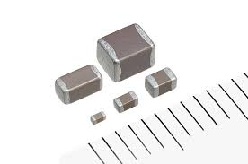
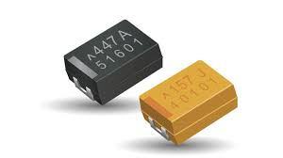
Procurement & Purchasing
Test Procurement – Part Selection
Types selected for purchase & testing
Tantalum capacitor:
A case 1206, 10uF, 10V (max CV available in both Auto and COTS)
MLCC capacitor:
10uF 25V, X7R, 1210 case (max CV available for Auto)
Test Sample MFG GRADE
#1 Supplier 4 Automotive
#2 Supplier 5 Automotive
#3 Supplier 6 Automotive
Test Sample MFG GRADE
#1 Supplier 1 Automotive
#2 Supplier 2 Automotive
#3 Supplier 3 Automotive
#4 Supplier 1 COTS
Note: there is no 10uF 25 1210 case COTS grade MLCC available, lower CV available only
470nF 25V X7R 1210 (low CV, max available for COTS)
Test Sample MFG GRADE
#4 Supplier 1 Automotive
#5 Supplier 1 CECC/COTS

Slide 12

Procurement & Purchasing
Parts Ordering Distributors - Communication
DISTRIBUTORS PARTS Online Database search issues
“special” low ESR tantalum or surge robust series is not in stock, full reel orders are accepted only
Distributors’ database is showing incorrect search results: Supplier 3 part in distributor database was not marked as AEC-Q200 qualified while manufacturer datasheet state the series is AEC-Q200. This degraded search filter results not showing supplier 3 parts as automotive part.
wrong presentation materials in link – tantalum wet capacitors on SMD part
wrong capacitor value in PN description – 470nF 25V MLCC described as 206uF
Datapack request:
• Manufacturer product datasheets are available in pdf to download from distributor website.
• Request for AECQ-200 data on the capacitors was actioned after placement of order

Slide 13
Procurement & Purchasing
Parts Ordering Distributors – Communication – Datapack Request
AEC-Q200 DATAPACK request from distributor based on placed order #
“all operators are busy, please hold the line” …
Calling distributor telephone hotline at weekday 1PM
Email communication
… after waiting 10minutes online I gave up and wrote an email to their contact email
EPCI
Distributor
Can you please send me AEC-Q200 datapack on Capacitors under # order ?
1 hour
“What is AEC-Q200 datapackage?”
AEC-Q200 datapack is …
24 hours
“for AEC-Q200 please contact manufacturers directly, we do not provide this data”.

Slide 14
Procurement & Purchasing
Datapack Request – Communication – Manufacturers
AEC-Q200 DATAPACK request
EPCI
Manufacturers – Online Support
Can you please send me AEC-Q200 datapack on Capacitors under # order from your authorized distributor?
Supplier 1,2 - general email online simple questionnaire to fill.
Supplier 3 – component type (capacitors) specific contact email
Supplier 4,5,6 - very detailed questionnaire including application details, potential market and PN.
Supplier 1: immediate automatic email acknowledgement response
filled questionnaire:
End Customer ….…………………………. European based space electronics manufacturer (SME)
Project …………….…………………………. general support technology evaluation
Application ………………………………… space hardware
Start Operation Production (SOP) .. 2-5 years
Estimated Annual Usage ……………… in thousands of parts annually
Supplier 2: immediate personal response asking on project specific numbers and questionnaire details
Suppliers 3,4,5 no immediate email feedback
Supplier 6:immediate automated email response with summary of the query, reference number and useful contacts to follow up

Slide 15
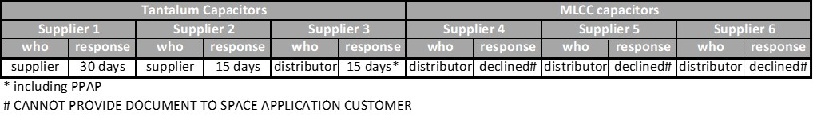
Procurement & Purchasing
Datapack Request – Communication – Manufacturers
Email communication
Can you please send me AEC-Q200 datapack on Capacitors under # order ?
EPCI
Manufacturers
EPCI
Distributor
Supplier 3,5,6: „this kind of information shall be supported by the direct distributor“
We were told to get AEC-Q200 datapack from you …
“patience please, I am checking on our side”
15 days
Supplier 2 provided AEC-Q200 datapackage
15 days
30 days
Distributor provided AEC-Q200 and PPAP datapackage from supplier 3
Supplier 1 provided AEC-Q200 datapackage
30 days
AEC-Q200 DATAPACK DELIVERY SUMMARY TABLE
Distributor informed us that Suppliers 4,5,6 refused to support this request

Slide 16
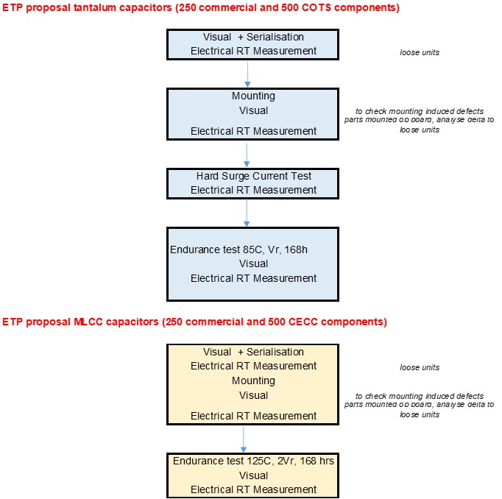


Ageing & Test Evaluation
Test Plan
Tantalum capacitor:
A case 1206, 10uF, 10V
Test Sample MFG GRADE
#1 Supplier 1 Automotive
#2 Supplier 2 Automotive
#3 Supplier 3 Automotive
#4 Supplier 1 COTS
MLCC capacitor:
10uF 25V, X7R, 1210 case:
Test Sample MFG GRADE
#1 Supplier 4 Automotive
#2 Supplier 5 Automotive
#3 Supplier 6 Automotive
470nF 25V X7R 1210
Test Sample MFG GRADE
#4 Supplier 1 Automotive
#5 Supplier 1 CECC/COTS

Slide 17
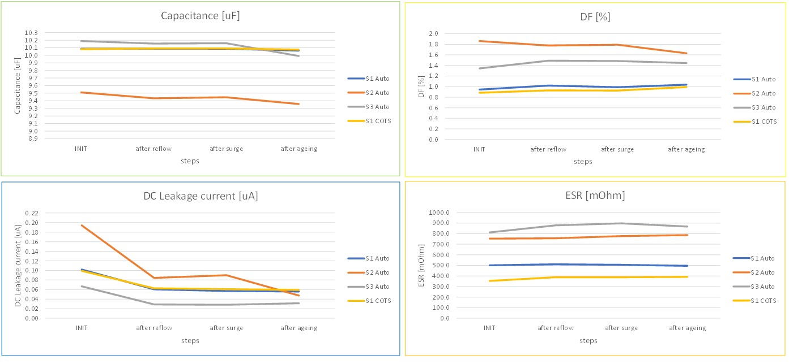
Ageing & Test Evaluation
Test Results – Tantalum Capacitors – Median Electrical Parameters

Slide 18
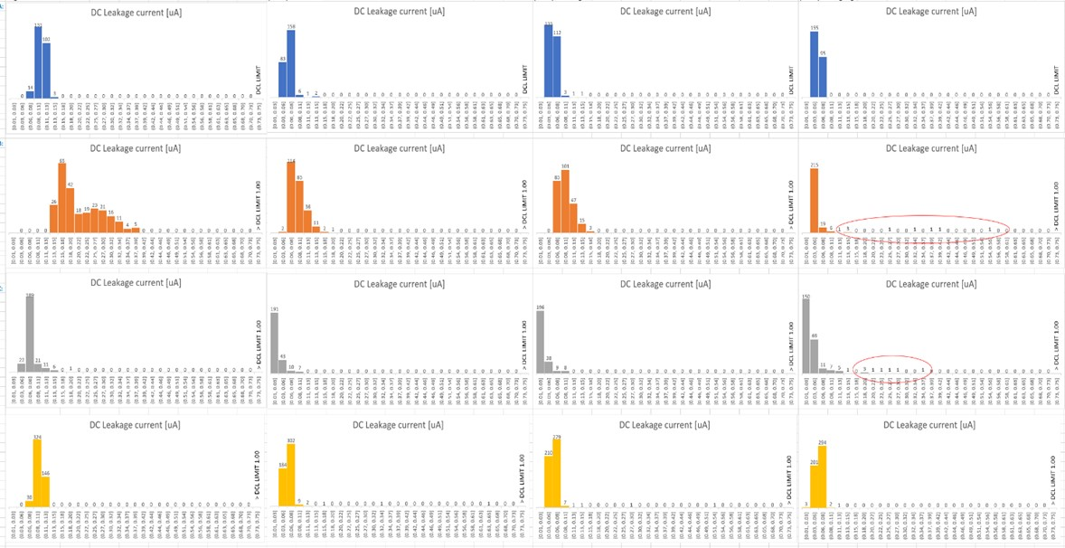
Ageing & Test Evaluation
Test Results – Tantalum Capacitors – DCL histogram
INITIAL LOOSE
POST MOUNT REFLOW
POST SURGE
POST 168h AGEING at VR, 85C
S1 Auto
S2 Auto
S3 Auto
S1 COTS

Slide 19
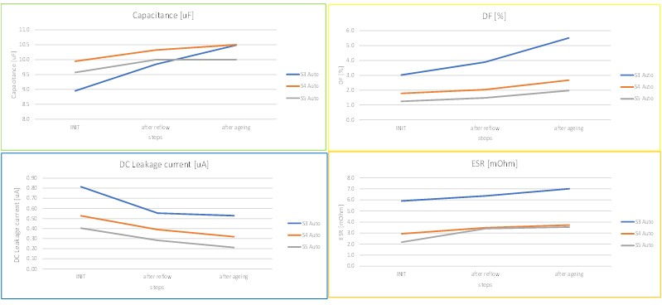
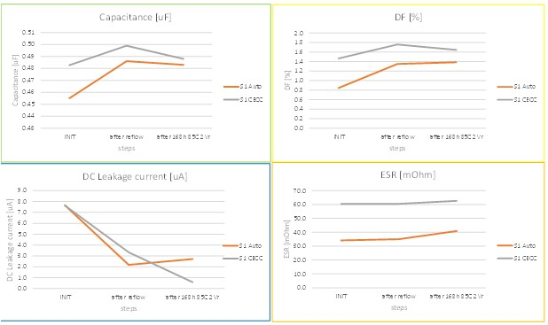
Ageing & Test Evaluation
Test Results – MLCC Capacitors
MLCC capacitor:
10uF 25V, X7R, 1210 case:
470nF 25V X7R 1210

Slide 20
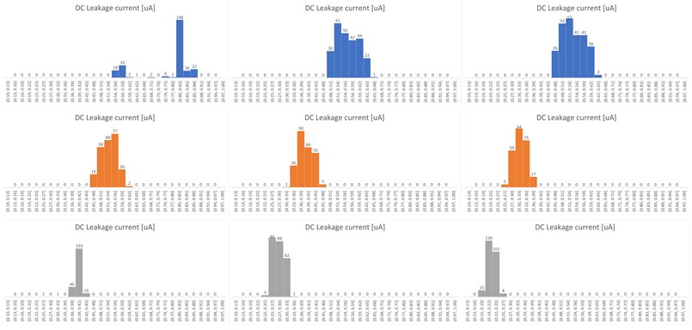
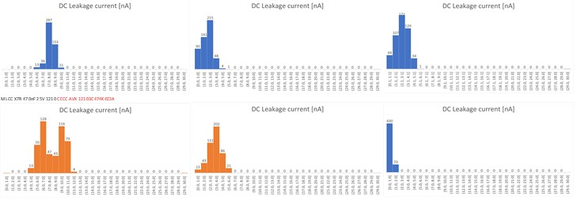
Ageing & Test Evaluation
Test Results – MLCC Capacitors – DCL histogram
MLCC capacitor:
10uF 25V, X7R, 1210 case:
470nF 25V X7R 1210
INITIAL LOOSE
POST MOUNT REFLOW
POST 168h AGEING at 2xVR, 125C
INITIAL LOOSE
POST REFLOW
POST 168h AGEING at 2xVR, 125C
S4 Auto
S1 Auto
S5 Auto
S1 COTS
S6 Auto

Slide 21
Test Summary
Electrical parameters of automotive & COTS/CECC tantalum and MLCC capacitors confirms effective screening testing and limits during manufacturing.
All tested tantalum and MLCC capacitors passed the ETP testing without any failures and meet manufacturer specifications.
All tantalum capacitors from all vendors in auto and COTS show high grade of robustness against hard surge current.
COTS tantalum capacitors exhibited high grade of robustness against hard surge current. DCL current and other el.parameters were stable and all parts successfully self-healed during the 168h 85C 1xVr ageing without any flyers.
168h ageing at 85°C/1xVr on tantalum capacitors have been proved as an effective process to stabilize its DCL with potential to improve reliability by removal of suspicious distribution tail parts by dynamic screening limits post ageing.
168h ageing at 125C 2xVr on 10uF 25V X7R 1210 MLCCs capacitors does not show any major impact to the measured electrical parameters. There were some differences observed in behaviour between the 470nF 25V X7R 1210 MLCC automotive commercial grade and CECC/COTS capacitors in test.
  Differences in capacitance distribution and DF/ESR values suggests that the two capacitor groups may have a different design (thickness of dielectric, layer structure, number of layers)
  ESR and DF of Auto CECC parts split into two distributions after board mounting thermal stress and stabilised after the 168h ageing. This was not the case of CECC/COTS parts
  DCL of CECC/COTS parts significantly decreased after the 168h ageing that was not case of automotive commercial parts. This phenomenon has not yet been explained - pending discussion with the manufacturer.

Slide 22
CONCLUSIONS
EPCI European Passive Components Institute
Component types and construction knowledge is required before purchasing. It is better to study, understand and select appropriate component type from concrete manufacturer before the procurement process. If the user is SME and have to buy through distributors there is a number of errors in their database and thus the search function may not be reliable. Technical support from distributor may be also varying.
Traceability of the auto parts is at very high level (required by automotive standards) and it should not be considered as an issue for space industry. (apart of MSL non-modular parts that require attention)
AEC-Q200 datapackage is not a public document and may not be necessary available. Getting the AEC-Q200 through supply chain and distribution may also take some time and communication resources.
Tantalum capacitors seems to be very robust and manufacturers are not so concerned about using their automotive products in SME space hardware. This is not the case of MLCC capacitors, where all manufacturers declare NO LIABILITY to their automotive parts for space application and refused to provide AEC-Q200 datapackage.
The test quantity may not be reasonable to make a general conclusion, nevertheless, there were no significant issues with the robustness of automotive grade tantalum and MLCC capacitors and they performed well in the evaluation testing.
On the other hand, testing of the original COTS / CECC level suggests that these parts have a more conservative component design focusing more reliability and robustness. This can be observed on lower shift of electrical parametric during the stress conditions and/or better recovery during ageing step.
168h ageing have been proved as an effective process to stabilize DCL distribution of capacitors
© EPCI 2021
CMSE 2021
22

Slide 23



INVITATION
EPCI European Passive Components Institute
3rd PCNS
7-10th Sep 2021, Milano, Italy
International conference dedicated to Passive Components
Bi-annual event hosted by European university
3rd PCNS 2021 hosted by Politecnico di Milano university
Intended as Hybrid event with streamed live speakers
Theme:
Reliability & Sustainability of Passive Components
The theme will be elaborated in conference Workshop, Hot Topic Panel Discussion, Keynote and papers selection preferences.
www.pcns.events
organized by EPCI European Passive Components Institute www.passive-components.eu
follow PCNS also on LinkedIn https://www.linkedin.com/showcase/pcns-events/
© EPCI 2021

Slide 24

Thank You !
EPCI European Passive Components Institute
EPCI Gold Members
EPCI Academy
Passive Components e-learning Courses
www.epci-academy.com
pdf report available for download:
(published on 11th March 2021)
https://passive-components.eu/cots-automotive-capacitors-procurement-and-evaluation-case-study-for-sme-space-hardware-manufacturer-esa-esccon-2021-epci-report/
Passive Components News
Educational and Information Blog on Passive Components
www.passive-components.eu
PCNS
Passive Components Networking Symposium
www.pcns.events

