Slide 1
Evolution of EEE European standards with regards to COTS and New Space
22 April 2021 CMSE
Denis Lacombe
Technical Reliability and Quality Division
ESA/ESTEC, Noordwijk,
The Netherlands

Slide 2
Agenda
Short introduction on EEE European standards for space application
Fast evolution of ESCC standards
Slow evolution of ECSS standards
New Space and EEE European standards
ESA mission classification

Slide 3

ESA News
https://www.esa.int/About_Us/Careers_at_ESA/ESA_Astronaut_Selection
Applications up to 28 of May 2021

Slide 4
Agenda
Short introduction on EEE European standards for space application
Fast evolution of ESCC standards
Slow evolution of ECSS standards
New Space and EEE European standards
ESA mission classification

Slide 5
European Space Standards for EEE component
In Europe, for space application, we use 2 sets of standards for EEE component
ESCC (European Space Components Coordination) specifications and documents contain: requirements for Individual EEE product characteristics and EEE family, Test methods, QA specifications, ESCC system methodologies, ESCC Procedures, ESCC QPL/QML (Certification)
ECSS (European Cooperation for Space Standardization) is an initiative established to develop a coherent, single set of “user-friendly” standards for use in all European space activities. See https://ecss.nl for more details.
ECSS-Q-ST-30-11C Derating - EEE components
ECSS-Q-ST-60C EEE Components
ECSS-Q-ST-60-13C Commercial electrical, electronic and electromechanical (EEE) components
ECSS-Q-ST-60-14C Relifing procedure - EEE Components
ECSS Q-ST-60-02C ASIC and FPGA development
ECSS-Q-ST-60-15C Radiation Hardness Assurance - EEE Components
ESCC and ECSS are not only ESA standardisation! ESA is supporting and is an active actor in these two collaborations

Slide 6
European Space Standards for EEE component
Evolution of EEE standards are due to 3 main reasons
Evolution of EEE component: Fast process
Lesson learned and new knowledge: Slow process
“External events” like New Space and constellation: Mix of fast and slow process

Slide 7
Agenda
Short introduction on EEE European standards for space application
Fast evolution of ESCC standards
Slow evolution of ECSS standards
New Space and EEE European standards
ESA mission classification

Slide 8
ESCC standards evolution – Fast process
New component lead to new standards

Slide 9
ESCC standards evolution – Fast process
Next evolutions: Supercapacitor, Press-fit connector, Photonics, ESCC 6001 (3D+ modules)
ESCC 9000P generic specification for Plastic encapsulated microcircuits
Major progress is related to Internal Visual Inspection for Plastic Encapsulated Components.
Addresses both Low and high volume manufacturing.
Agreement has been reached to inspect encapsulated devices.
De-capsulation strategy on the difficulties of leaving artifacts after the process.
General update to the ESCC 9000 P standard includes:
Insertion of the ESCC 25300 “Decapsulation of plastic encapsulated devices”.
Requirement for all materials shall be in compliance with the ECSS-Q-ST-70-02C “Thermal Vacuum Outgassing test for screening of space materials”.
Use of the JESD 22-B116 “Wire-bond shear test” method.
Requirements for : Internal Visual Inspection, “Wire bond pull” and “Wire bond shear” tests, Die shear, Substrate attach strength or Flip-chip pull-off, Lid Pull, High Temperature Stabilization bake, and Constant Acceleration.

Slide 10
Agenda
Short introduction on EEE European standards for space application
Fast evolution of ESCC standards
Slow evolution of ECSS standards
New Space and EEE European standards
ESA mission classification

Slide 11
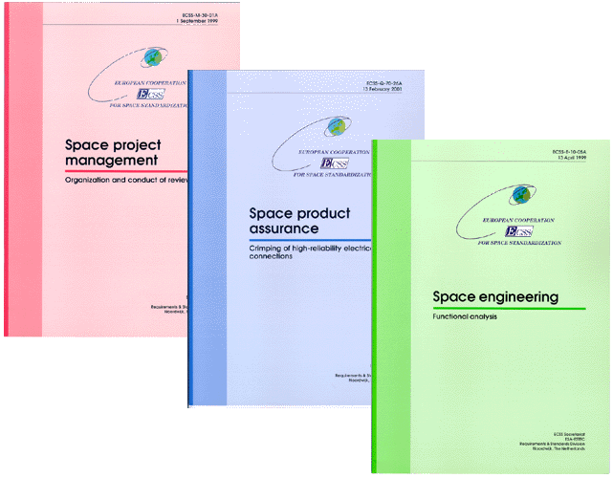
ECSS standards evolution – Slow process
ECSS-Q-ST-30-11 Derating- EEE Components (see additional slides): The WG dispositioned all the comments received during the Public Review and the draft is expected soon.
ECSS-Q-ST-70-61 High reliability assembly for surface mount and through hole connections: The WG is focusing on the last inputs from the ESA Soldering School, last meetings on the final convergence are planned for January/February 2021.
ECSS-E-ST-20-40 ASIC and FPGA engineering: The first draft submitted to the ECSS Secretariat in December 2021. Update of ECSS-Q-ST-60-02.
ECSS-Q-ST-60 Electrical, electronic and electromechanical (EEE) components: The review is starting with already more than 150 proposed modifications
https://ECSS.nl

Slide 12
ECSS-Q-ST-30-11: Derating standard (2011)
Modification of radiation requirement to refer to ECSS-Q-ST-60-15 as a general rule.
Change of junction temperature for active devices: Deviation for Si to increase the maximum junction temperature if the part are properly evaluate according to ESCC 2269010 and 2265010 if max rating junction temperature above 150C then the Tj can be 125C or Tjmax-25C.
Derating for GaN transistor: Tj= the lower of 145C or Tjmax-25C. Deviation to increase the maximum junction temperature if the part are properly evaluated according to ESCC 2269010 and 2265010 if max rating junction temperature above 200C then the Tj can be 160C.
Ceramic capacitor: Remove the requirement of the low voltage test at 85C/85RH
Modification of heater derating based on temperature and not power: T<Max rated temperature minus 50C
Modification of wire and cable derating. A formula is proposed to determine the max temperature of individual wire. This will allow to take into consideration the environmental temperature. Coefficient for fully loaded bundle and partially loaded bundle. Permission to use simulation if properly justified.

Slide 13
ECSS-E-ST-20-40 ASIC and FPGA engineering (2008)
New ECSS-E-ST-20-40 (engineering requirements) and revised ECSS-Q-ST-60-02 (quality assurance requirements)
• Higher clarity, simplicity
• Covering different flows for ASIC (digital and analog), FPGA and IP Cores
• Better definitions of Specifications, Development, Verification and Validation Plans
• Parallel/serial submodule developments, iterations, additional intermediate reviews or fewer reviews (according to device complexity and criticality)
• Special attention to HW-SW co-engineering (coordinated with ECSS-E-ST-40 SW engineering WG), when using embedded processing cores using Software
• Consistent terminology , also wrt new SW ECSS-E-ST-40 /Q-ST-80 standards
• special attention Analogue/Mixed ASICs requirements and flow
• new Annexes and figures with pre-tailoring of flows/requirements per device type and its criticality
• Compatible with evolving IC technologies, higher functional complexities, CAD tools
For more detail, please see presentation given in ESCCON 2021 (https://escies.org).

Slide 14
Agenda
Short introduction on EEE European standards for space application
Fast evolution of ESCC standards
Slow evolution of ECSS standards
New Space and EEE European standards
ESA mission classification

Slide 15
New Space and EEE European standards
New Space for EEE is mainly the use of non qualified EEE component (COTS or automotive)
and covered by ECSS-Q-ST-60-13
Points to be considered for space application are:
Assessment of reliability
“Forbidden” material like pure tin
Radiation
What are the difficulties for standardisation?
Should be based on lesson learned and accumulation of data/knowledge (slow process)
But industry is evolving fast due to competitivity constraints
Need for a standardisation effort even if not perfect

Slide 16
ECSS-Q-ST-60-13 Commercial EEE component (2013)
The update will address three main topics
Authorization of pure tin parts without retinning:
whisker risk analysis and compliance with JEDEC 201 class 2
Automotive level recognition based on AEC-Q100, AEC-Q101 and AEC-Q200 (grade 0 and 1)
Commercial passive parts introduction
Ceramic capacitors chips
Solid electrolyte tantalum capacitors chips
Fuses
Magnetic parts
Film resistors chips
Thermistors

Slide 17
ECSS-Q-ST-60-13 Commercial EEE component (2013)
Ceramic capacitors chips
Automotive grade | Class 1 | Class 2 | Class 3 | Category | Test type | Test Procedure
AEC-Q grd 0/1 | X | X | X | Evaluation | Construction Analysis | ESCC21001
AEC-Q grd 0/1 | X | X | X | Evaluation | Temperature characterization | ESCC3009 8.10
AEC-Q grd 0/1 | X |  |  | Evaluation | Life Test 2000h | ESCC3009 8.6 + 8.9
AEC-Q grd 0/1 | X |  |  | Screening | Complete screening | ESCC3009 chart F3
AEC-Q grd 0/1 | X | X | X | LAT | DPA | ESCC21001
AEC-Q grd 0/1 | X | X |  | LAT | Life Test 1000h | ESCC3009 8.6 + 8.9
No | X | X | X | Evaluation | Construction Analysis | ESCC21001
No | X | X | X | Evaluation | Temperature characterization | ESCC 3009 8.10
No | X | X |  | Evaluation | Complete evaluation | ESCC 3009 chart F4
No |  |  | X | Evaluation | Life Test 1000h | ESCC3009 8.6 + 8.9
No | X | X | X | Screening | Complete screening | ESCC3009 chart F3
No | X | X | X | LAT | DPA | ESCC21001
No | X |  |  | LAT | Complete LAT | ESCC 3009 chart F4
No |  | X | X | LAT | Life Test 1000h | ESCC3009 8.6 + 8.9
Discrete parts (diodes, transistors, optocouplers)
Automotive grade | Class 1 | Class 2 | Class 3 | Category | Test type | Test Procedure
AEC-Q | X | X | X | Evaluation | Radiation evaluation | i.a.w. ECSS-Q-ST-60-15
AEC-Q | X | X | X | Evaluation | Construction Analysis | i.a.w. Annex H + outgassing
AEC-Q | X |  |  | Evaluation | Life Test 2000h | test methods i.a.w. table 8-2-1
AEC-Q | X | X | X | Screening | Hermiticity | test methods i.a.w. table 8-2-2
AEC-Q | X | X | X | Screening | PIND test | test methods i.a.w. table 8-2-2
AEC-Q | X |  |  | Screening | Complete screening | test methods i.a.w. table 8-2-2
AEC-Q | X | X | X | LAT | RVT | i.a.w. ECSS-Q-ST-60-15
AEC-Q | X | X | X | LAT | Construction Analysis | i.a.w. Annex H
AEC-Q | X | X |  | LAT | Life test | test methods i.a.w. table 8-2-3 and 8-2-6
No | X | X | X | Evaluation | Radiation evaluation | i.a.w. ECSS-Q-ST-60-15
No | X | X | X | Evaluation | Construction Analysis | i.a.w. Annex H + outgassing
No | X | X |  | Evaluation | Complete Evaluation | test methods i.a.w. table 8-2-1 and 8-2-4
No | X | X | X | Screening | Hermiticity | test methods i.a.w. table 8-2-2
No | X | X | X | Screening | PIND test | test methods i.a.w. table 8-2-2
No | X | X |  | Screening | Complete screening | test methods i.a.w. table 8-2-2 and 8-2-5
No | X | X | X | LAT | RVT | i.a.w. ECSS-Q-ST-60-15
No | X | X | X | LAT | Construction Analysis | i.a.w. Annex H
No | X | X | x | LAT | LAT i.a.w. ECSS-Q-ST-60-13 Rev C | test methods i.a.w. tables 8-2-3, 8-2-6 and 8-2-7

Slide 18
Agenda
Short introduction on EEE European standards for space application
Fast evolution of ESCC standards
Slow evolution of ECSS standards
New Space and EEE European standards
ESA mission classification

Slide 19
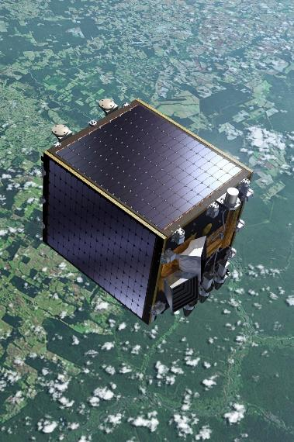
Mission classification : ESA NEW CHALLENGES
Enabling and Supporting
Space is transitioning from a low-volume business dominated by public organisations to a highly competitive and dynamic business environment.
Industry has an active role and demands higher effectiveness and efficiency to achieve low cost and time to market.
ESA Technology Strategy aims at boosting international competitiveness through the establishment of concrete and measurable ambitious targets.
ESA needs to introduce new working methods aiming at reducing cost and development times.
The growing interest in the application of COTS (Commercial Off The Shelf: EEE Components, Software, PCBs, etc…) in institutional missions is an example of this increasing need.
Notes:
We are facing new challenges in space domain, in term of low-volume business to a high competitive business environment, where the industry has an active role that requires high effectiveness to achieve low cost and time to market.
So the ESA Technology Strategy needs to introduce new working methods aiming at reducing cost and development times where the high interest in application of COTS in space missions is an example of this increasing need.

Slide 20
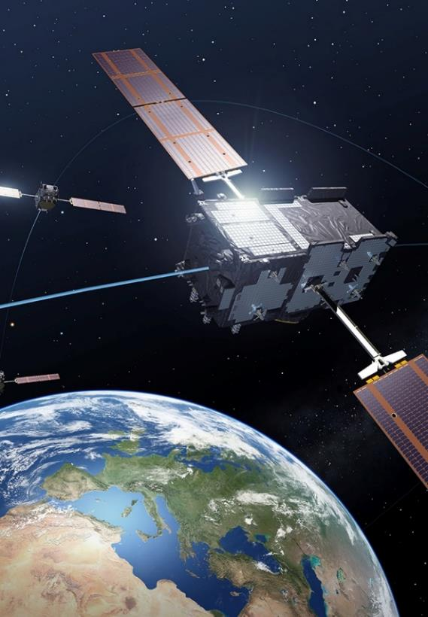
ESA MISSION CLASSIFICATION
Status report on the ESA COTS Steering Committee was presented to ESA Executive Board in 2019 (EB76, 28/10/2019) and a go-ahead was given to prepare an ESA mission classification similar to what is already adopted by NASA. Inside a specific mission, any subsystem or equipment that constitutes part of a mission may be separately categorised.
ESA Mission Classification provides:
ESA programme and project managers a framework to define the appropriate management, engineering and product assurance controls, tailored to the profile of the mission.
A systematic approach for optimising resources in accordance with mission objectives.
Programme and project managers a framework to develop novel implementation strategies in areas such as project management, system engineering and product assurance.
A basis for the introduction of novel elements (e.g. COTS) and working methods aiming at reducing development time and cost.
ESA & its Member States a new structured framework to manage the programmatic risks.
Notes:
ESA is currently establishing a mission classification that allows project and PA Managers to define the appropriate management controls for their mission.
And the probability of failure management becomes a systematic process to optimize resources in accordance with mission constraints like cost, mission lifetime, complexity and technology maturity.
So we can say that Mission classification makes easier to communicate the acceptable level of mission probability of failure throughout the supply chain

Slide 21
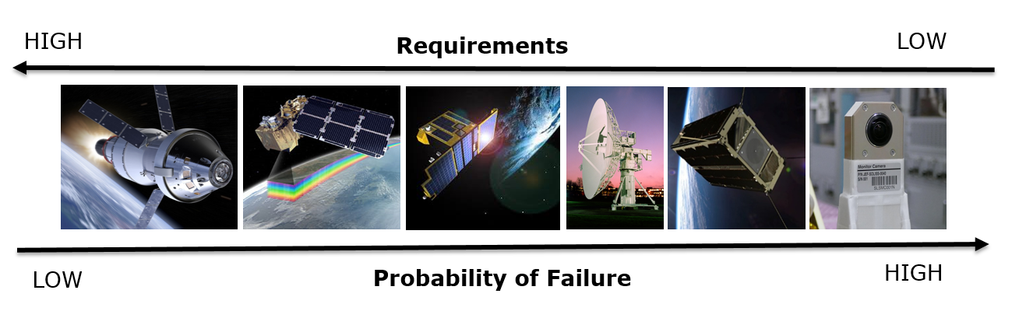
ESA Mission Classification
Decision: An ESA Mission Classification with associated tailoring rules should be defined according to ESA’s stakeholders acceptability of failure to be traded against mission implementation costs.

Slide 22
ESA MISSION CLASSIFICATION TABLE
Class Type | I | II | III | IV | V
Mission Criteria
Criticality to the Agency Strategy (flagship mission, international cooperation, impact on ESA Strategic goals and image) | Extremely High Criticality | High Criticality | Medium Criticality | Low Criticality | Educational purposes
Mission objectives (Directorate priority and purpose, e.g. in-orbit demonstration, educational) | Extremely High Priority | High Priority | Medium Priority | Low Priority | Educational purposes
Cost (Cost at completion including phase E1) | >700M€ | 200-700M€ | 50-200M€ | 50-1M€ | <1M€
Mission Lifetime (nominal mission life duration) | >10 years | 5-10 years | 2-5 years | 2 years - 3 months | <3 Months
Mission complexity (design interfaces, unique payloads, new technology development) | High | High to Medium | Medium to Low | High (IOD/IOV) Low (Commecially driven ) | Low
Notes:
ESA is currently establishing a mission classification that allows project and PA Managers to define the appropriate management controls for their mission.
And the probability of failure management becomes a systematic process to optimize resources in accordance with mission constraints like cost, mission lifetime, complexity and technology maturity.
So we can say that Mission classification makes easier to communicate the acceptable level of mission probability of failure throughout the supply chain

Slide 23
Thanks for your attention
See you at ACCEDE 2022 (Spring, Seville/Spain)
https://ESCIES.ORG
https:// ECSS.nl
https://SPACECOMPONENTS.ORG
http://www.esa.int

