Slide 1

Guidelines for Space Qualification of GaN HEMTs and MMICs
John Scarpulla
Components for Military and Space Electronics (CMSE)
19-23 April 2021

Slide 2
Background
Status of space qual of GaN RF/Microwave HEMT technology
GaN RF/microwave HEMTs and MMICs are beginning to find their way into Class A and B space missions
  GaN HEMT advantages:
    High power density High temperature operation
    High voltage capability Radiation hard
  GaN HEMT issues
    Trapping phenomena causes new problems
    Current collapse, pulse-to-pulse instability, low frequency noise etc.
    Piezoelectric effects at high voltage may generate even more traps
No official GaN government standards presently exist for qualification in space
  Existing standards cover Si, GaAs devices
Aerospace TOR (Tech. Operating Report) was an attempt to fill this gap
Now holding GaN working group discussions
  continue to improve and update TOR
  demonstrate the test protocols as recommended in the TOR
    DC tests HiRev-funded / RF tests Aerospace IRAD-funded
Please request TOR-2018-00691(A) “Guidelines for Space Qualification of GaN HEMT Technologies” J. Scarpulla, C. Gee from “heather.power@aero.org”

Slide 3
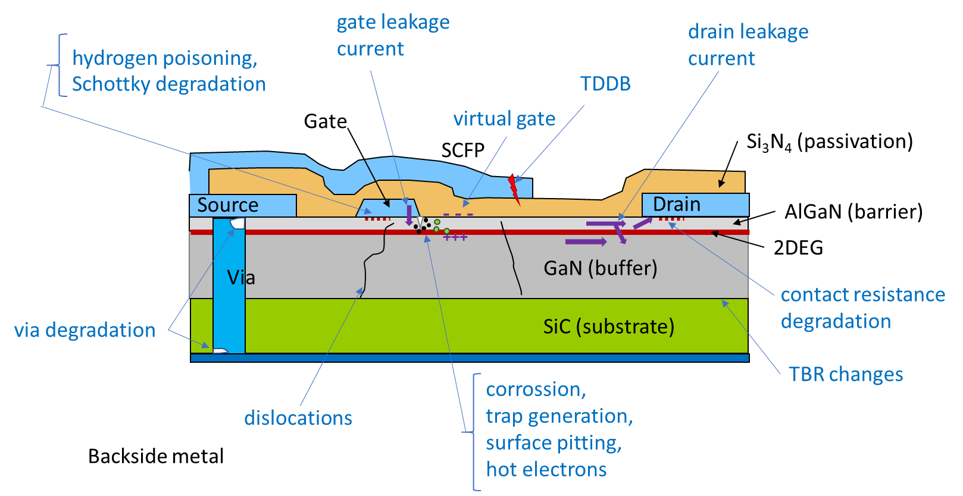
Failure Mechanisms in GaN HEMTs
Understanding of the failure modes guides qual testing
Electron currents indicated
Different failure modes operate in different electrical regimes

Slide 4
MIL PRF 19500 vis-a-vis TOR-002018-00691(A)
older mil procurement spec. inadequate for GaN RF/μW transistor
screening Group A Group B Group B Group C
inspection inspection (JANS) inspection (JAN,JANTX,JANTXV) periodic inspection
more items in work:
  list of things that are missing from MIL-PRF 19500
  extend to MIL PRF 38535 ICs (eg. MMICs)
TOR addresses the major disconnects (red items)
Need to modify many requirements from MIL PRF 19500 to apply to GaN HEMT

Slide 5
Safe Operating Area for a GaN HEMT
burnout points must be far removed from area of operation
GaN HEMTs do not have a sustainable breakdown voltage – must derate severely

Slide 6
The IV Plane
Recommendations for accelerated life testing (ALT)
The “DC vs. RF” question – can DC rel testing be sufficient for an RF device?

Slide 7
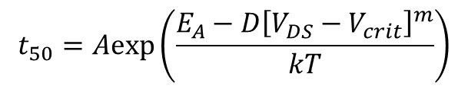
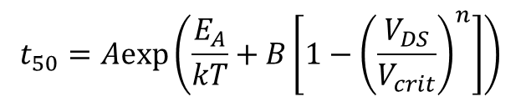
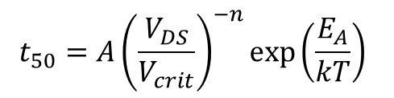
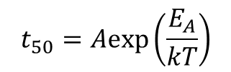
Possible Models for GaN HEMT reliability
median times to failure t₅₀ are found to change in characteristic above a certain critical drain voltage, V_{crit}
above V_{crit} there may be a TDDB effect
voltage-independent:
$$t_{50}=Aexp\left(\frac{E_{A}}{kT}\right)$$
V_{crit} = 25V
V-indep
voltage-dependent for V > V_{crit}:
$$t_{50}=A{\left(\frac{V_{DS}}{V_{crit}}\right)}^{−n}exp\left(\frac{E_{A}}{kT}\right)$$
V-power
Median time to fail, t₅₀ (hours)
V-exp
coupled V-exp
$$t_{50}=Aexp\left(\frac{E_{A}}{kT}+B\left[1−{\left(\frac{V_{DS}}{V_{crit}}\right)}^{n}\right]\right)$$
$$t_{50}=Aexp\left(\frac{E_{A}−D{\left[V_{DS}−V_{crit}\right]}^{m}}{kT}\right)$$
T_{ch} = 200°C
Drain voltage, V_{DS} (Volts)
these proposed models are under investigation

Slide 8
DOE plan for life testing
experimental “cells” to extract model parameters
Q2 (I high, V low)
Q1 (IV central)
T3
Q3 (I low, V high-dark points)
&
Channel Temperature
Q4 (I =0, V high-light points)
T2
T1
V_{crit}
V_{max.safe}
Drain Voltage, V_{DS}
DC testing voltage/temperature combinations

Slide 9
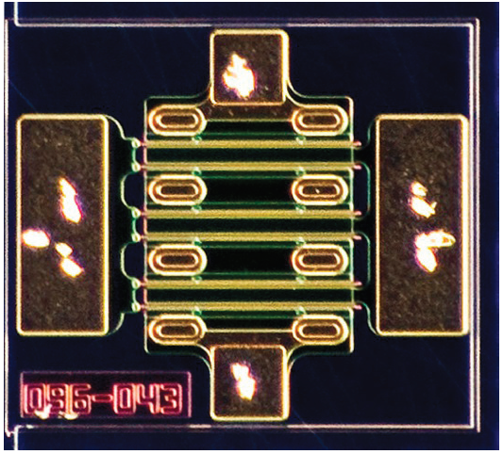
Test plan answering the “DC v. RF” reliability question
Q4 off state
Q3 semi-on
state
Q2 hi current/low
voltage state
Step Stresses
(SS)
5V steps
5V steps
100mA
steps
250°C 75V
325°C 75V
325°C 1A
STARTING HERE
Q1 traditional
DC mid voltage/mid current state
(already available)
RF-driven
250°C 85V
250°C
300°C 85V
300°C 1A
Constant Stress Accelerated Tests
250°C 95V
275°C 95V
275°C 1A
multi-power level
RF stress test.
DC stress conditions . Correlation sought to RF usage
Test vehicle Cree/Wolfspeed CGH60008D 8W, 6GHz GaN HEMT die

Slide 10
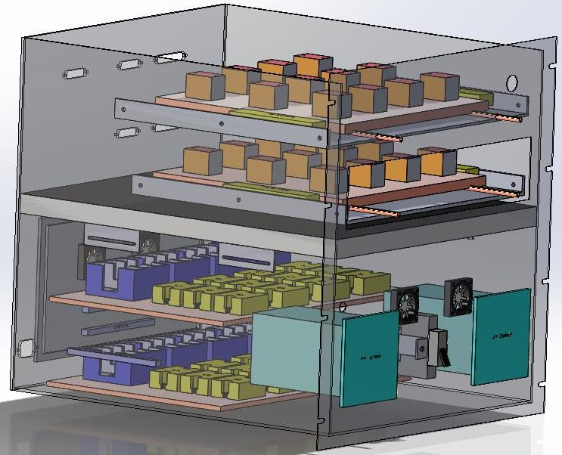
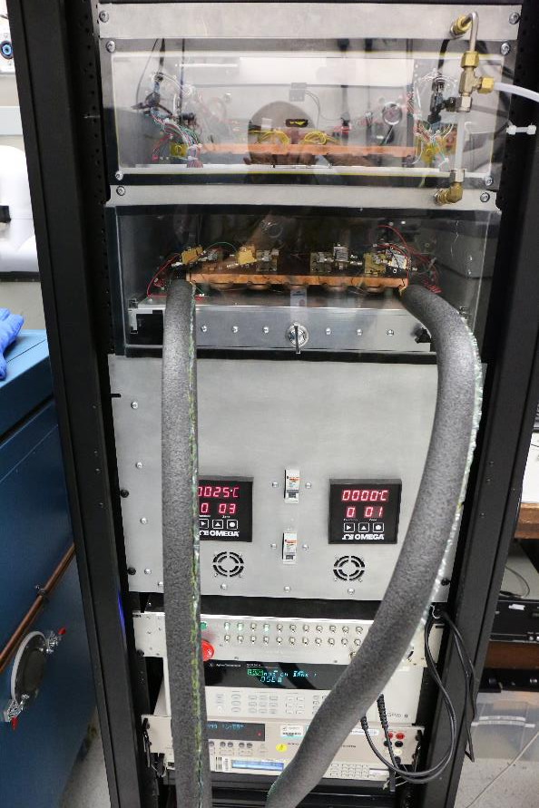
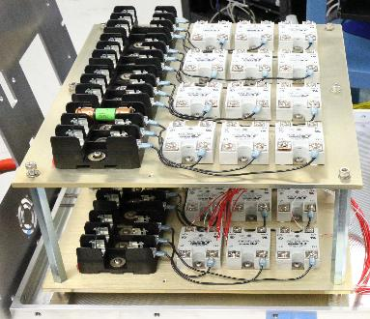
DC test system
Thermal Fixtures
Cold Plates
DUT Compartments
Power Compartment
Limit Controllers
SSRs
120VAC Fuses
Thermal Control & DC Bias PCB Box

Slide 11
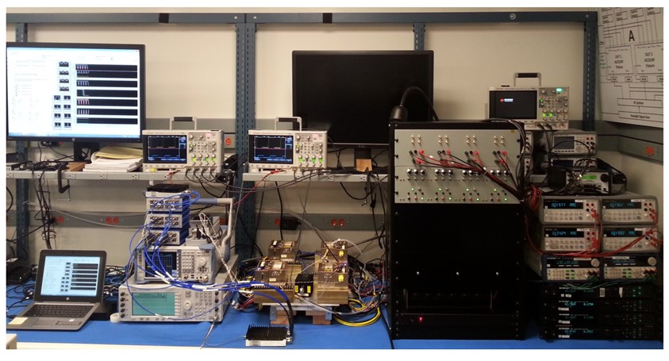
RF Test System
protection circuits
drain and gate current meters
Instruments:
spectrum analyzer,
RF switches,
oscilloscope,
pulser, RF source
drain power supplies
LabView software
4 DUTs in modified Accel-RF™
fixtures mounted on cold plate
Custom test set developed for unattended continuous operation

Slide 12
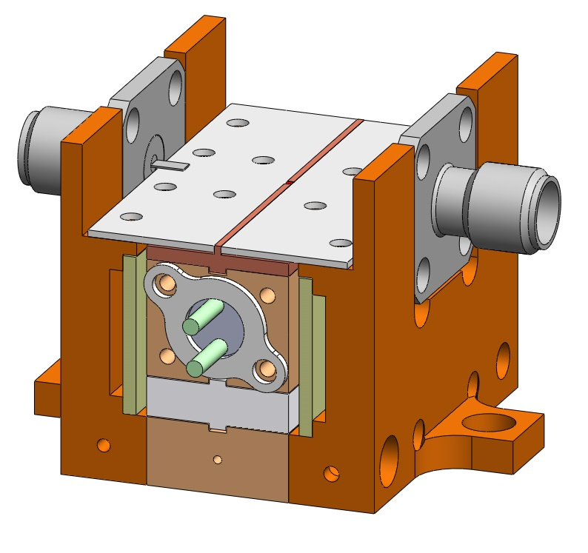
Test Fixture
to bias DUT in an RF-stable environment, and to operate under high temperature acceleration
Fixture assemblies with carriers, substrates and devices complete
  Baselined GaN device
  Conducted high temperature step stress test
Next steps
  Further characterize fixtures
    S-Parameters
  Conduct more thermal tests
  Analyze test results
    Verify thermal model
  Machine 24 fixtures for life-test (DC) – in work
  Modify this fixture design for RF lifetest
TC5
TC1
TC4
TC3
TC2 on cold plate, near fixture

Slide 13
Pulsed IV measurement scheme
GaN trapping locations and densities can be delineated
0.5
QE
0.5
R
Don
static
static
I
I
QE
DSS
QF
D
(A/mm)
(A/mm)
QF
V
0
0
T
0
V
(V)
-
DS
10
4
V
(V)
0
GS
sweep
20
10
μ
20
V
s
V
DS
DS
10
(V)
10
(V)
3
0
0
QE
QF
QE
QF
V
V
0
GS
0
GS
(V)
-
(V)
-
4
4
sweep
time
time
(a)
(b)
Traps generated via aging may encumber pulsed RF operation

Slide 14
Other Issues related space usage of GaN HEMTs
lingering concerns not yet fully understood
Moisture-induced Corrosion
  An electrochemical reaction between the gate metal and the AlGaN barrier has been shown to generate pits or corrosion sites in the presence of moisture
  Raises concerns about the traditional 5000 ppmV moisture level deemed acceptable in hermetic modules
Ammonia
  High temperature advanced packaging materials such as AlN are under consideration for space usage
  in the presence of moisture, the reaction AlN + 3H₂O → Al(OH)₃ + NH₃ may ensue
  also a reaction with GaN die 2GaN + 3H₂O → Ga₂O₃ + 2NH₃ may ensue
  ammonia may potentially be extremely deleterious
Hydrogen Poisoning
  GaN HEMTs may experience hydrogen poisoning by a mechanism similar to GaAs
  hydrogen typically evolves from Au/Ni plated Kovar housings commonly used
  requires gettering or other amelioration
more data needed

Slide 15
More Recommendations & Test Protocols
Topics to consider for space qualification of GaN (as delineated in TOR)
Robustness
  SOA (safe operating area)
  Gate burnout
  RF burnout
  ESD
  Temperature cycling
  Power cycling
  Off-state voltage screening
Intrinsic Reliability
  DC lifetesting (4 Q-points)
  RF lifetesting
  Step stressing
  TLYF (Test Like You Fly)
  Thin film resistors
  Electromigration
Environmental Effects
  Moisture sensitivity
  Hydrogen sensitivity
  Air Sensitivity
Extrinsic Defects
  MIMCAPs
  Gate Defects
  Airbridge Defects
  Backside Via defects
Mechanical
  Backside metal adhesion
  Bondpull tests
  Die shear tests
  Step Coverage
  Low Frequency Oscillations
Radiation Effects
  Total Ionizing Dose
  Dose Rate
  Singe Event Effects SEE, SEB
  Displacement Damage
  GaN dosimetry, LET
Ratings and Derating
  Reliability, burnout and SEB considerations
Guidelines are provided on these topics and more

Slide 16
Conclusion
A peer-reviewed and vetted space qualification methodology for GaN power HEMTs and MMICs is available
TOR-2018-00691(A) “Guidelines for Space Qualification of GaN HEMT Technologies” J. Scarpulla, C. Gee
  Please contact heather.power@aero.org to join GaN working group / receive a copy
DC and RF-driven lifetesting is in progress
to confirm the recommendations in the TOR
  funded by a combination of HiRev and Aerospace IRAD
ACKNOWLEDGEMENTS
  Jeremy Bonsall
  Chris Clark
  Brendan Foran
  Albert Young
  AFRL’s HIREV GaN Team
THANK YOU!

