Slide 1
Why GaN in Space?
Shengke Zhang, Ph.D.
Notes:
In this presentation we will answer the question, why GaN power transistors and ICs are the best choice for power conversion application in space-based systems.
GaN devices offer dramatically improved performance over the aging Rad Hard silicon MOSFET, enabling a new generation of power converters in space operating at higher frequencies, higher efficiencies, and greater power densities than ever achievable before.

Slide 2
Why GaN in Space?
Radiation tolerance of GaN vs. Silicon
Failure mechanisms of GaN
Superior electrical performance of GaN
Space applications and solutions
Notes:
(Build 1) First, we will explain why eGaN devices exhibit such superior radiation tolerance compared with silicon MOSFETs. (Build 2) We explore some of the failure mechanisms in GaN and how they impact radiation performance. (Build 3) We will then show how superior is the electrical performance of eGaN transistors compared with the most popular Rad Hard MOSFETs. (Build 4) Lastly, we will discuss some spaceborne systems where GaN is enabling higher radiation and system performance compared to silicon solutions.

Slide 3
Radiation in Space
Gamma radiation
Neutron radiation
Heavy ions
Notes:
There are several types of radiation experienced by semiconductors in space. Devices in satellites in orbit around our earth, or in exploration satellites visiting our most distant parts of our solar system, all experience some form of high-energy radiation bombardment. Three of the primary types of radiation are (build 1) gamma radiation, (build 2) neutron radiation, and (build 3) heavy ion bombardment.

Slide 4
Failure Mechanisms
Trapping
Physical damage to the crystal
Momentary short due to electron-hold cloud
Notes:
An energetic particle can cause damage to a semiconductor in three primary ways; (build 1) it can cause traps in non-conducting layers, (build 2) it can cause physical damage to the crystal – also called displacement damage, or (build 3) it can generate a cloud of electron-hole pairs that will cause the device to momentarily conduct, and possibly burn out in the process.
In eGaN devices energetic particles cannot generate momentary short-circuit conditions because you cannot generate mobile hole-electron pairs. So we will focus on the first two mechanisms (build 4), trapping and physical damage.

Slide 5
Gamma Radiation – Si MOSFETs
Positive Charges
Polysilicon Gate Electrode
Body Diode
Silicon Dioxide Gate
Source
Aluminum
++++++++++++++
N-Type Si Epitaxial Layer
Channel Region
Si
Drain
Notes:
Gamma radiation consists of high energy photons that interact with electrons. Here is a cross section of a typical silicon MOSFET. It is a vertical device with the source and gate on the top surface, and the drain on the bottom surface. The gate electrode is separated from the channel region by a thin silicon dioxide layer (build 1). In a silicon based MOSFET, the gamma radiation knocks an electron out of the silicon dioxide layer leaving behind a positively charged trap in the gate oxide (build 2). These positive charges reduce the threshold voltage of the device until the transistor goes from normally off – or enhancement mode – to normally on – or depletion mode. At this point the system will need a negative voltage to turn the MOSFET off. Typical ratings for Rad Hard devices range from 100 kilo Rads to 300 kilo Rads. In some cases, devices can be made to go up to 1 M Rad, but these tend to be very expensive.

Slide 6
Gamma Radiation – eGaN® Transistors
AlGaN Electron Generating Layer
Dielectric
S
G
D
Two Dimensional Electron Gas (2DEG)
-
-
-
-
-
-
-
-
-
-
-
-
-
-
-
-
-
-
-
GaN
Aluminum Nitride Isolation Layer
Si
Notes:
Enhancement mode GaN devices are built very differently from a silicon MOSFET. All three terminals, gate, source, and drain, are located on the top surface. Like in a silicon MOSFET, conduction between source and drain is modulated by biasing the gate electrode from zero volts to a positive voltage – usually 5 V. Notice that the gate is separated from the underlying channel by an aluminum gallium nitride layer (build 1) This layer does not accumulate charge when subjected to gamma radiation.

Slide 7
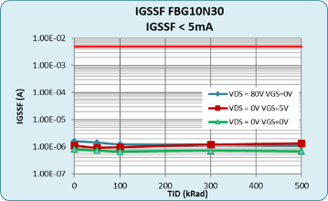
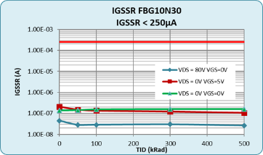
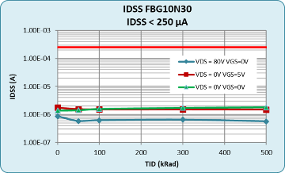
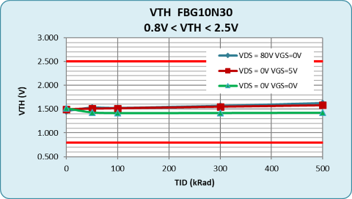
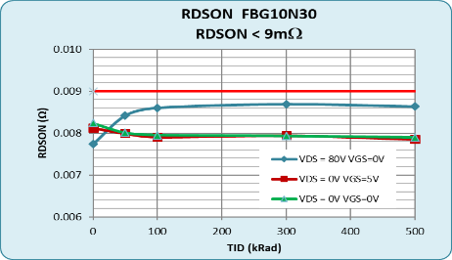
Gamma Radiation – eGaN Transistors
FBG10N30
Notes:
To demonstrate this performance, we subjected our 100 V family of eGaN transistors to 500 k Rad of Gamma radiation. We measured the leakage currents from drain to source and gate to source, as well as the threshold voltage and on-resistance of the devices at various checkpoints along the way, confirming that there are no significant changes in device performance. We have since taken devices out to 50 Mrads confirming that eGaN devices will not be the first part to fail due to gamma radiation in any space system.

Slide 8
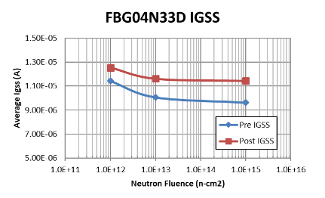
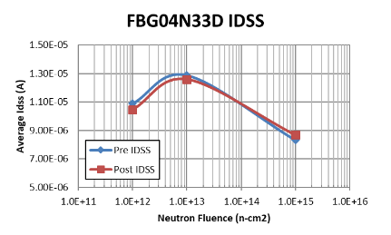
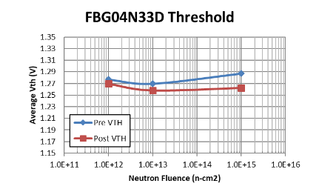
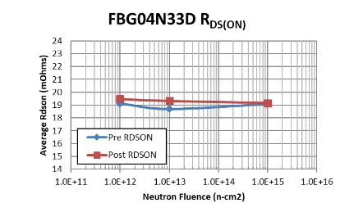
Neutron Radiation
Notes:
The primary failure mechanism for devices under neutron bombardment is displacement damage. High energy neutrons will scatter off atoms in the crystal lattice and leave behind lattice defects. Here we are showing the impact of neutron radiation at doses up to 1 x 10¹⁵ per square cm. As with gamma radiation, the impact of neutrons on the GaN crystal and the entire device structure is minimal.

Slide 9
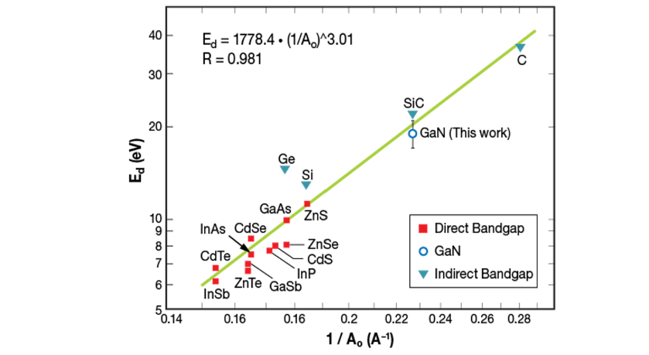
Displacement Damage
Si
GaN
Notes:
The reason for GaN’s superior performance under neutron radiation is that GaN has a much higher displacement threshold energy compared with silicon. In this graph you can see the displacement energy on the vertical axis compared with the inverse of the lattice constant for various crystals. (build 1) Note how much higher the displacement energy of GaN is compared with silicon.

Slide 10
Single Event Effects – Si MOSFETs
Au
Body Diode
Polysilicon Gate Electrode
Silicon Dioxide Gate
Source
Aluminum
N-Type Si Epitaxial Layer
Gate Rupture
Si
Drain
Notes:
SEE are caused by heavy ions generated by the impact of galactic cosmic rays, solar particles or energetic neutrons and protons. This can be simulated terrestrially by using a cyclotron to create beams of different ions. Two of the most common ions used to evaluate radiation tolerance of electronics components are Xenon ,with a Linear energy transfer, or LET, of about 50 MeV·cm2/mg, and Gold, with an LET of about 85 MeV·cm2/mg.
In a silicon MOSFET there are two primary failure mechanisms caused by these heavy ions, single event gate rupture, or SEGR, and single event burnout, or SEB. Single event gate rupture is caused by the energetic atom (build 1) causing such a high transient electric field across the gate oxide that the gate oxide ruptures (Build 2).

Slide 11
Single Event Effects – Si MOSFETs
Au
Body Diode
Silicon Dioxide Gate
Polysilicon Gate Electrode
Source
Aluminum
- - - - - - - -
++++++++
N-Type Si Epitaxial Layer
Si
Drain
Notes:
Single event burnout, or SEB is caused when the energetic particle transverses the drift region of the device where there are relatively high electric fields. The energetic particle loses its energy while generating a large number of hole electron pairs (build 1) . These hole electron pairs cause the device to momentarily short circuit between drain and source. This short circuit can either destroy the device, and this is call single event burnout, or the device can survive but it appears as a momentary short circuit that can cause damage to other components in the system. This latter case is call single event upset, or SEU.

Slide 12
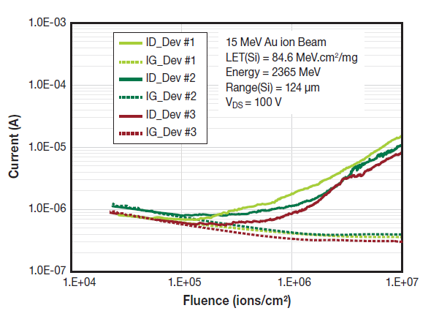
Single Event
Notes:
Since eGaN devices do not have a gate oxide, they are not prone to single event gate rupture. Since eGaN devices to not have the ability to conduct large numbers of holes very efficiently, they are also not prone to single event upset. (build 1) Shown in this graph is the primary failure mechanism for eGaN devices under heavy ion bombardment. The conditions are about the maximum conditions possible, with an 85 LET beam of gold atoms pummeling the device biased at the maximum data sheet limit. The vertical axis is the device leakage current while the horizontal axis is the number of heavy ions absorbed by the device per square centimeter. The dotted line shows the gate-to-source leakage current, and the solid line shows the drain-to-source leakage current for three separate FBG10N30 100 V eGaN transistors. Note that the gate leakage does not go up during bombardment. The drain-source leakage, however, does start to rise as the displacement damage from the heavy ions increases.

Slide 13
SEE Safe Operating Area
FBG20N18
FBG30N04
Notes:
EPC Space has tested many products for SEE under varied conditions.
40 V and 100 V product did not fail under any conditions up to full rated voltage and 87 LET. (build 1) Shown here on the left are the results from several FBG20N18 200 V products. (build 2) In the red circle you can see that the first failures occurred at 85 LET and 190 V. (build 3) The FBG30N04 300 V product, on the right, failed at 85 LET and 310 V (build 4).

Slide 14
Electrical Performance Comparison at 100 V
Notes:
Now that we have shown that eGaN devices outperform the aging Rad Hard silicon MOSFET in radiation tests, let’s look at the electrical performance comparison. Here we are comparing two 100 V Rad Hard eGaN transistors against the IRHNA67160 power MOSFET from Infineon. Highlighted in green are the characteristics of the eGaN transistor that are superior to their MOSFET counterpart. On the left, the FBG10N30 packaged part from EPC Space has half the on-resistance, yet is one-tenth the size and has about one-twentieth the gate and gate-drain charges that determine switching speed. In addition, the radiation resistance is significantly higher. The device on the right is a smaller part in the 100 V range, yet displays similar relative superiority.

Slide 15
Electrical Performance Comparison at 200 V
Notes:
At 200 V the difference in electrical performance of the eGaN transistors is even greater. The device on the left has similar on-resistance to its MOSFET counterpart, yet is one-tenth the size, and has about 30 times better switching performance while demonstrating superior radiation resistance. The smaller device on the right has about the same performance ratios.

Slide 16
Applications
Notes:
Now that we’ve examined the superior radiation and electrical performance of eGaN devices, let’s take a look at some of the applications where these products are used.

Slide 17
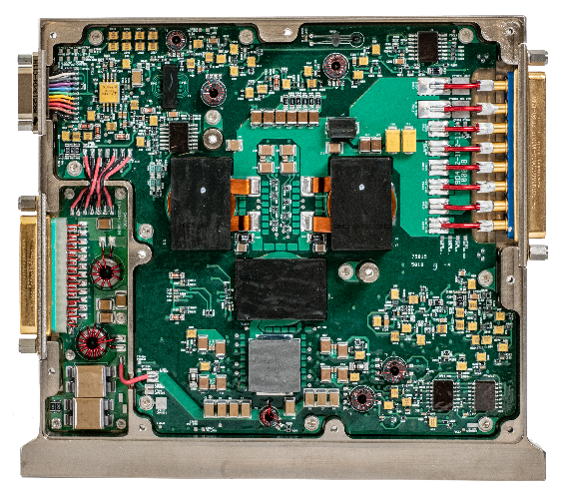
DC-DC Conversion
96%
V_{IN} = 100
V_{OUT} = 28
SGRB10028S Series Converter from VPT
Notes:
Power supplies used in harsh environments, such as space, high-altitude flight, or high-reliability military applications must be resistant to damage or malfunctions caused by ionizing radiation.
Rad Hard GaN enables power converters operating at higher frequencies, higher efficiencies, and greater power densities for Micro, LEO, GEO satellites, along with deep space and outer space explorations.
Here’s an example of a space-qualified DC-DC converter for satellite power from our friends at VPT using Rad Hard GaN FETs from EPC Space. The peak efficiency reaches 96%, compared to typical MOSFET solutions which do not typically exceed the low 90% range

Slide 18

Lidar
Why GaN?
Increase resolution
Increase range
Increase frame speed
Smaller size/lower weight
Notes:
Another application in space for GaN is lidar. Lidar systems provide the “eyes” for autonomous navigation and docking for rendezvous missions and robotics used in space. The shorter the laser beam pulse, the higher the resolution of the lidar images. GaN devices provide this needed speed, increase the efficiency, and shrink the size for lidar.

Slide 19
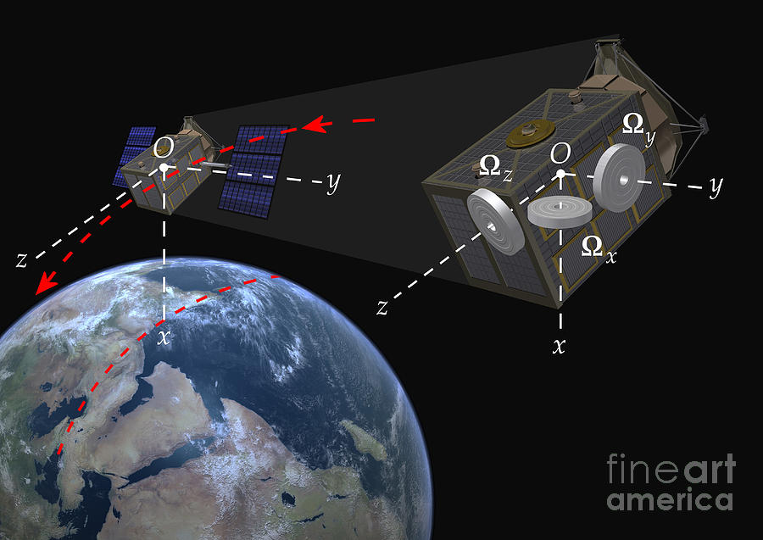
Satellites Reaction Wheel
Why GaN?
Improve precision
Smaller size/lower weight
Faster response
Lower EMI
Notes:
Reaction Wheels are a critical component for satellites as it enables them to stay orientated and reposition while in orbit. The reaction wheel operates by controlling the rotational speed of the electric motor attached to the flywheel. Rad Hard GaN power devices provide the small size, light weight, and precision control that DC motors require and can withstand the harsh environment.

Slide 20
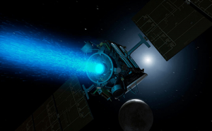
Ion Thrusters
Why GaN?
Higher efficiency
Increased power delivery
Smaller size/lower weight
Notes:
An ion thruster is a form of electric drive used for in-mission spacecraft propulsion with uses such as orientation and positioning of satellites and interplanetary propulsion of low-mass robotic vehicles. Rad hard GaN enables smaller, lighter, more efficient power supply to these systems, increasing the power delivery.

Slide 21
eGaN Devices for Space
Significantly different failure mechanisms compared to silicon MOSFETs
When exposed to various forms of radiation, eGaN devices are more rugged than Rad Hard MOSFETs
Superior electrical performance compared to aging silicon power MOSFET
Most efficient, smallest, most reliable solution for spaceborne systems
Notes:
In summary, (build 1) eGaN devices have significantly different failure mechanisms compared to silicon MOSFETs.
(build 2) When exposed to various forms of radiation, eGaN devices are more rugged that Rad Hard MOSFETs.
(build 3) The electrical performance of eGaN devices is many times superior to the aging silicon power MOSFET.
(build 4) eGaN devices are the most efficient, smallest, most reliaible solution for spaceborne systems including DC-DC power converters, lidar systems, motor drives, and ion thrusters.

Slide 22
epc.space
Notes:
For more information please visit epc.space

