Slide 1
Stacked Polymer Tantalum Capacitors – Advanced Packaging Technology
CASE COMPARISON
_____________________________________________
Joe Vattimo
Sr. Product Manager
Tantalum Division - Polymer April 20th, 2021

Slide 2
Stacked Polymer Tantalum Capacitors - Agenda
AMS customers’ challenging “problem statement”
Tantalum Capacitor Product Hierarchy
Advantages of Vishay Anode Technology
T54 Hi-Rel COTS Screening and Performance of Individual Components
Technical Details of Stack Construction
Vishay Hi-Rel COTS Polymer Capacitors Skyline
Stack Assembly and Testing Flow Chart
T54 Hi-Rel COTS Screening and Performance of Polymer Stacked Solutions
Robust Mechanical Performance: Shock and Vibration
Vishay Leading-Edge CAP – Voltage Offering in T54 Vishay Hi-Rel COTS
Summary of Features >>> Advantages >>> Benefits
Dedications

Slide 3
Problem Statement:
Addressing AMS Customers’ Demanding Design Requirements
Many customers’ designs require the use of high capacitance values for bulk energy storage
Their applications and environmental requirements demand highly reliable, ruggedized capacitor solutions
While “footprint” comes at a premium, these various applications can often make use of available vertical space
These challenges require an innovative design approach to fulfill the rigorous requirements frequently facing our AMS customers
Where to begin?

Slide 4
Tantalum Capacitor Product Hierarchy
Space
Mil-Spec
Reliability Performance
Price
Hi-Rel COTS
Commercial-Grade Capacitors
Product Breadth

Slide 5

Advantages of Vishay Anode Technology
Process step | Industry practice | Vishay practice | Advantage of Vishay technology
Anode delubrication | Thermal [burn-out @ 1000 ºC] carbon content ~300 ppm | Our proprietary process guarantees carbon content ≤30 ppm | Defect-free dielectric; Low DC leakage; Long term reliability
Process | Oxygen content ~5000 ppm | Added proprietary process reduces oxygen content to ~4000 ppm
Wire attachment | Embedded Good strength attachment | Welded Excellent strength attachment | Improved ability to withstand reflow stress

Slide 6
DCL Values and Carbon %
Tantalum Powder: 23K CV/g; 1550°C sintering; 120V Dielectric Formation

Slide 7
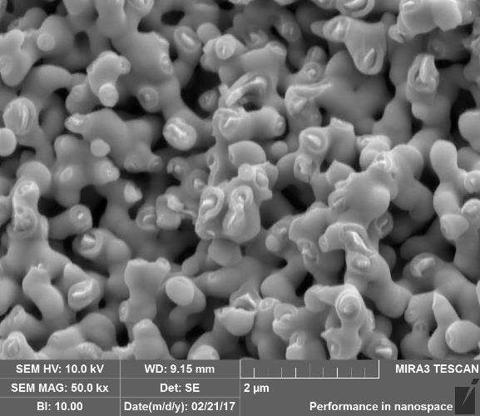
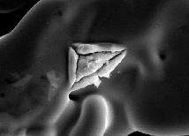
Advantages of Vishay Anode Technology
Typical appearance of crystals in Ta₂O₅ dielectric
Defect-free Ta₂O₅ dielectric formed over high CV sintered Ta slug by anodization at 50 V.
No crystals found!

Slide 8
T54 Hi-Rel COTS Screening Flow Chart
Reflow conditioning
MIL-PFR-55365 par. 4.7.10
Surge current testing, including
+25 °C and -55 °C / +85 °C options
MIL-PFR-55365 par. 4.7.18
Accelerated voltage conditioning
MIL-PFR-55365 par. 4.7.5
Thermal shock:
-55 °C / +125 °C, 5 cycles
method 107 of MIL-STD-202
Statistical DC leakage (DCL) screening at elevated temperature and voltage
Statistical DCL and ESR screening at room temperature and rated voltage
MIL-PFR-55365 par. 4.7.6
Finished individual components
100 % screening: MIL-PFR-55365 style

Slide 9
Statistical DCL Screening at Elevated Temperature and Voltage
(Patent No.: US 10,381,166 B2 (45) Date of Patent: Aug. 13, 2019)
Screening process steps:
100 % electrical test at Vr, room temperature, with [Avg + 3σ] statistical limit: much lower than 0.1 CV (450 uA)
Hot DCL sample test at elevated temperature and voltage > Vr. test voltage derived from BDV distribution
Statistical analysis of sample test in order to define new HDCL test limit [Med, sigma]
Perform hot DCL test for entire lot with [Med + 2σ] statistical limit
100 % electrical test @ Vr,
RT DCL, uA
Hot DCL test
DCL, uA
BDV is significantly higher!
“hidden” Outliers removed!
0.1CV = 450 uA
DCL _{Median} + 2σ
T54 150 µF - 30 V EE
Breakdown voltage test

Slide 10
T54 150 µF – 30 V EE: Stable Performance at 85 °C, Vr Endurance Test… 8000 Hour Life Test

Slide 11
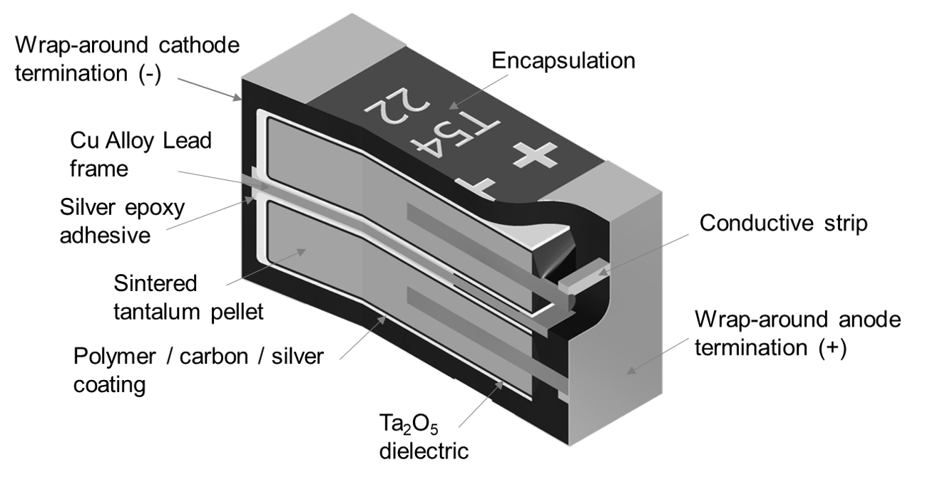
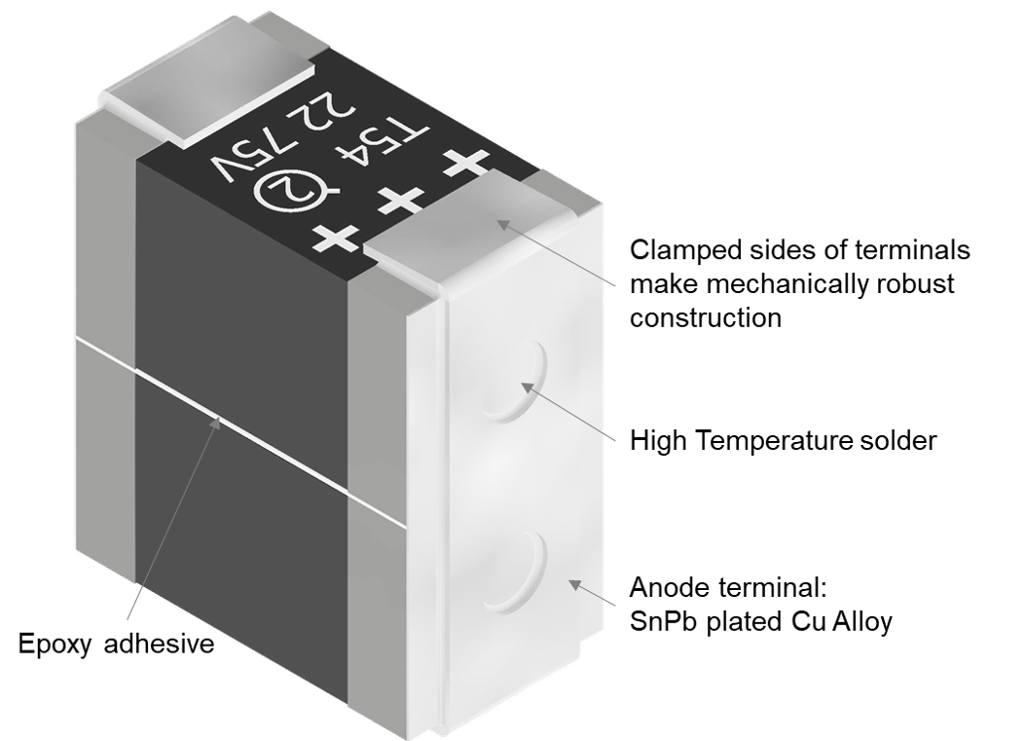
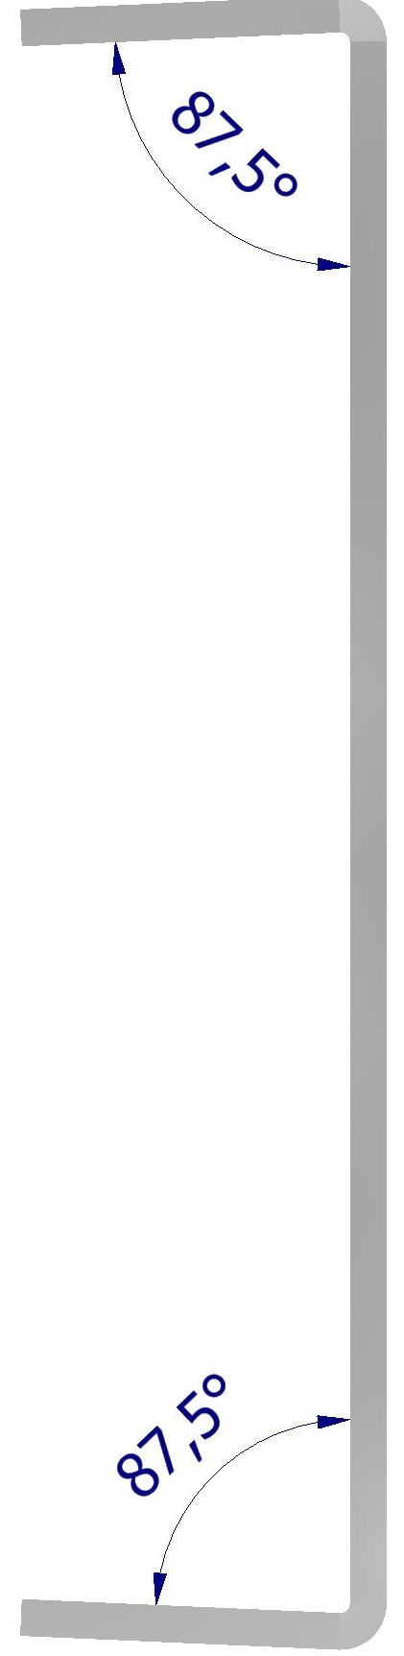
Construction: Caps to Stacks

Slide 12
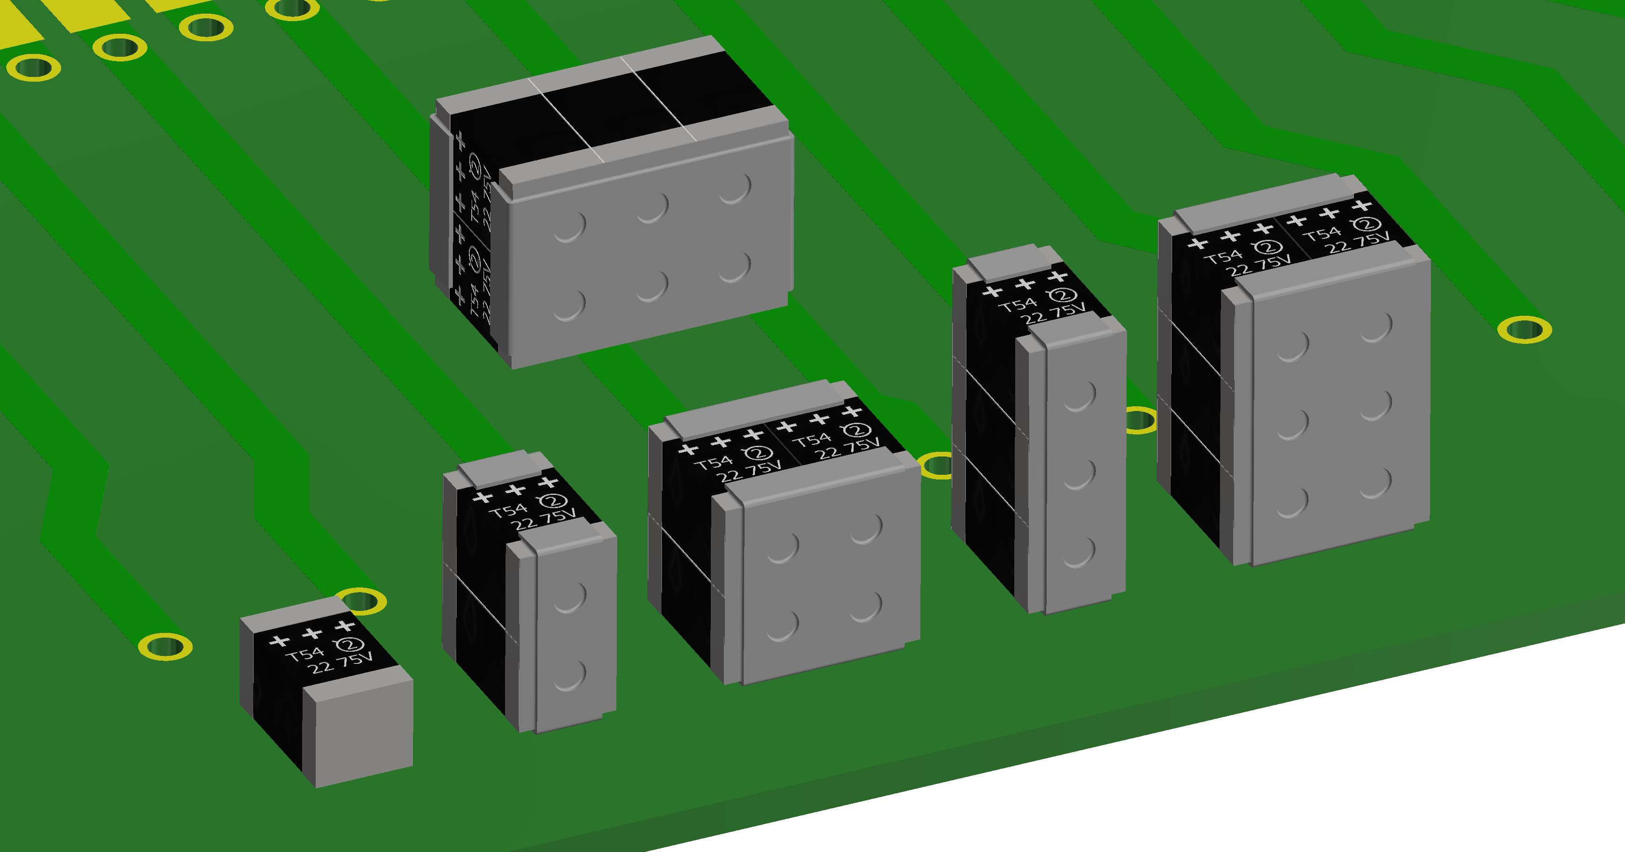
Vishay Hi-Rel COTS Polymer Capacitors Skyline
Product | T54 EE Single | T54 E2 Stack | T54 E4 Stack | T54 E3 Stack | T54 E6 Stack
Footprint [metric] | 7343 - 43 | 8044 - 89 | 8089 - 89 | 8044 - 130 | 8089 -130
Energy [0.5 CV²] | 0.06 J | 0.12 J | 0.19 J | 0.25 J | 0.37 J

Slide 13
T54 Polymer Stacks Assembly and Testing Flow Chart
Finished individual components
MIL-PFR-55365 style 100 % screened
Assembly of capacitor stacks
100 % reflow conditioning
100% inspection:
visual, dimensions, electricals
Packing and shipping

Slide 14
T54 22 uF & 130 µF – 75 V Frequency Characteristics: Stable CAP, Low ESR
ESR distribution 130µF-75V, 17mΩ
Median ESR 6.7mΩ

Slide 15
T54E6 130 uF - 75 V Vibration Test (MIL-STD-202, Method 204, Condition D, 10 Hz to 2000 Hz 20 g Peak)
: Represents limits for ratings and specifications

Slide 16
T54E6 130 uF – 75 V Mechanical Shock (MIL-STD-202, Method 213, Condition E, 1000 g Peak – Not 100 g Peak)
: Represents limits for ratings and specifications

Slide 17
T54 Vishay Hi-Rel COTS: Full CAP / Voltage Range
T54Ex ⁽¹⁾: RATINGS AND CASE CODES (ESR mΩ)
μF | 16 V | 30 V | 35 V | 50 V | 63 V | 75 V
30 |  |  |  | E2 (50) |  | E2 (50)
45 |  |  | E2 (50) |  | E2 (50) E3 (35) | E2 (50) E3 (35)
60 |  |  |  | E4 (25) |  | E4 (25)
66 |  |  | E3 (35) |  | E3 (35) | E3 (35)
90 |  |  | E4 (25) |  | E4 (25) E6 (17) | E4 (25) E6 (17)
95 |  | E2 (35/28) |  | E2 (50)
130 |  |  | E6 (17) |  | E6 (17) | E6 (17)
140 |  | E3 (25/18) |  | E3 (35)
190 |  | E4 (18/14) |  | E4 (25)
280 |  | E6 (12/10) |  | E6 (17)
300 |  | E2 (75, 38)
450 | E2 (13) | E3 (50, 25)
600 |  | E4 (38, 20)
660 | E2 (13) E3 (9)
900 | E4 (7) | E6 (25, 13)
940 | E2 (13, 10)
990 | E3 (9)
1300 | E4 (7) E6 (5)
1400 | E3 (9, 7)
1900 | E4 (7, 5)
2000 | E6 (5)
2800 | E6 (5)
T54EE: RATINGS AND CASE CODES (ESR mΩ)
μF | 16 V | 30 V | 35 V | 50 V | 63 V | 75 V
15 |  |  |  |  | EE (100) | EE (100)
22 |  |  |  | EE (100) | EE (100) | EE (100)
47 |  |  | EE (70) | EE (100)
150 |  | EE (150, 75)
220 | EE (25)
330 | EE (25)
470 | EE (25)
Leading-Edge CAP / Voltage Offering

Slide 18
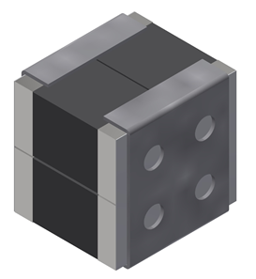
Stacked Polymer Capacitors – Features, Advantages, & Benefits
Features
Stacked capacitor solutions are primarily made from T54 EE-case (Hi-Rel) or T59 EE-case (industrial), and customer-specific requests are available as well (T52 stack, etc.)
Customers can order stacks of 2, 3, 4, or 6
Capacitance: 30 µF – 2800 µF Voltage ratings: 16 V – 75 V
Operation up to 125 ºC
High reliability screening available
Ultra low ESR; very tight distribution due to statistical screening
Both 100 % tin (RoHS-compliant) and tin / lead (Pb) terminations are available
Fully SMD compatible
Very high ripple current capacity
Standard polymer derating: 80 % applied / rated voltage
Customer-Specific Solutions Available as Well
Advantages vs Individual Components
Makes better use of available height in customer design; Choose your max height: 4.3 mm 9.9 mm 13.7 mm
Side by side stacks keep parts closer together, increasing capacitance density and reducing wasted board space
Parts come as a fully integrated and tested package; less solder joints
All stacks can be tested in accordance with Vishay Hi-Rel COTS (Mil) screening regiment
Benefits to Customer
Reduced board space
Higher density design
Eliminates the need for custom solutions
Maximum capacitance in a single package
High reliability; reduced infant mortality; long service life

Slide 19
Additional contributions by:
Alex Eidelman, Vice President R&D, Vishay Tantalum Division, Dimona, Israel
Stanislav Zlatopolsky, R&D Project Leader, Vishay Tantalum Division, Dimona, Israel
Yuri Stangrit, Engineering Manager, Vishay Tantalum Division, Dimona, Israel

Slide 20
Vishay Tantalum Capacitors Leading the Industry in Design Innovation
THANK YOU!

