Slide 1
Surface-Mount Wet Tantalum Capacitors
CMSE 2021
Jon Rhan
Sr. Marketing Product Manager, Wets Tantalum Division
15 Daigle Lane, Sanford, Maine
207-490-7213

Slide 2
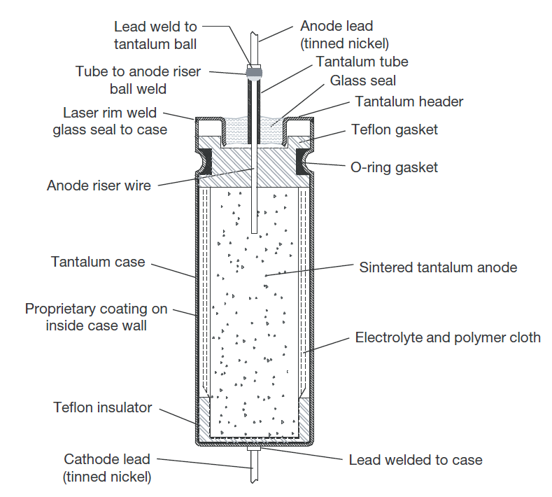
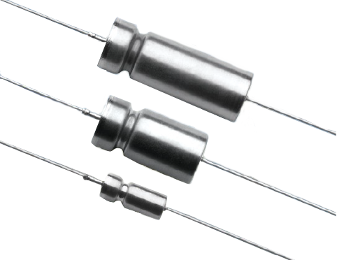
Wet Tantalum Capacitor Definition
What is a wet tantalum capacitor ? It is a tantalum capacitor with a liquid electrolyte as opposed to a solid, such as MnO2 or polymer
High reliability dielectric with a unique self-healing effect resulting in :
Low leakage current (> 10 times less than solids)
Higher capacitance at higher voltage (up to 150 V)
Harsh environment operation (performance)
High Temperature operation (up to 200°C)
Good surge current capabilities
Notes:
Slide to briefly demonstrate what we are talking about…..wets, not solids.

Slide 3
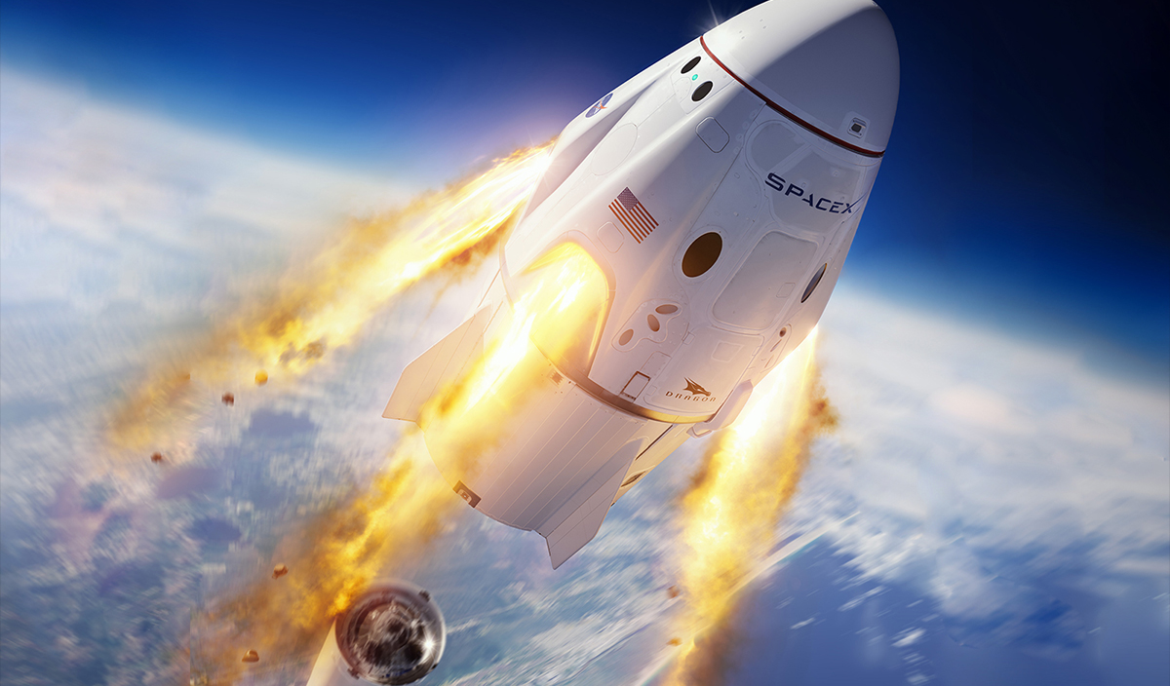
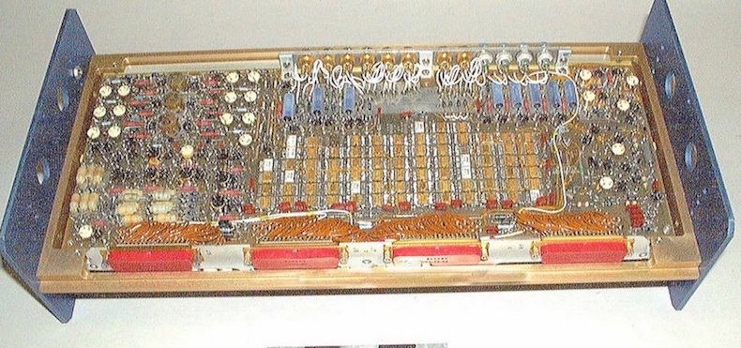

The Need for High Reliability: When Failure is not an Option
The Vishay (formerly Sprague Electric) 135D wet tantalum capacitor series and its MIL equivalent series (MIL-PRF-39006/22) were developed for the NASA space shuttle program.
Prior to the 135D, the industry was using silver-cased capacitors. The use of higher currents - and sometimes the presence of reverse voltages, which lead to catastrophic failure – resulted in the devices being banned from space applications.
NASA offered grants to two companies to develop a more robust capacitor; Sprague was one of them.
The resulting 135D was used in many spacecraft, including Voyager 1 and 2, which were launched in 1977 and have now left our Solar System….
Sprague 135D’s
Pictures courtesy of NASA and NASM: https://futurism.com/nasas-twin-voyager-probes-are-the-most-important-spacecraft-ever-launched/
https://www.si.edu/object/nasm_A19990063000?width=85%25&height=85%25&iframe=true&destination=spotlight/guidance-navigation-and-control
Notes:
Slide to show history…….

Slide 4
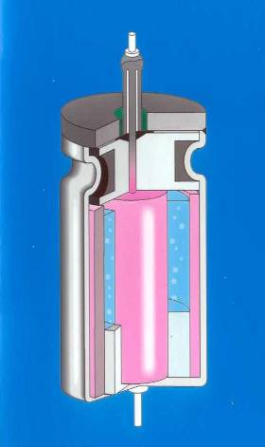
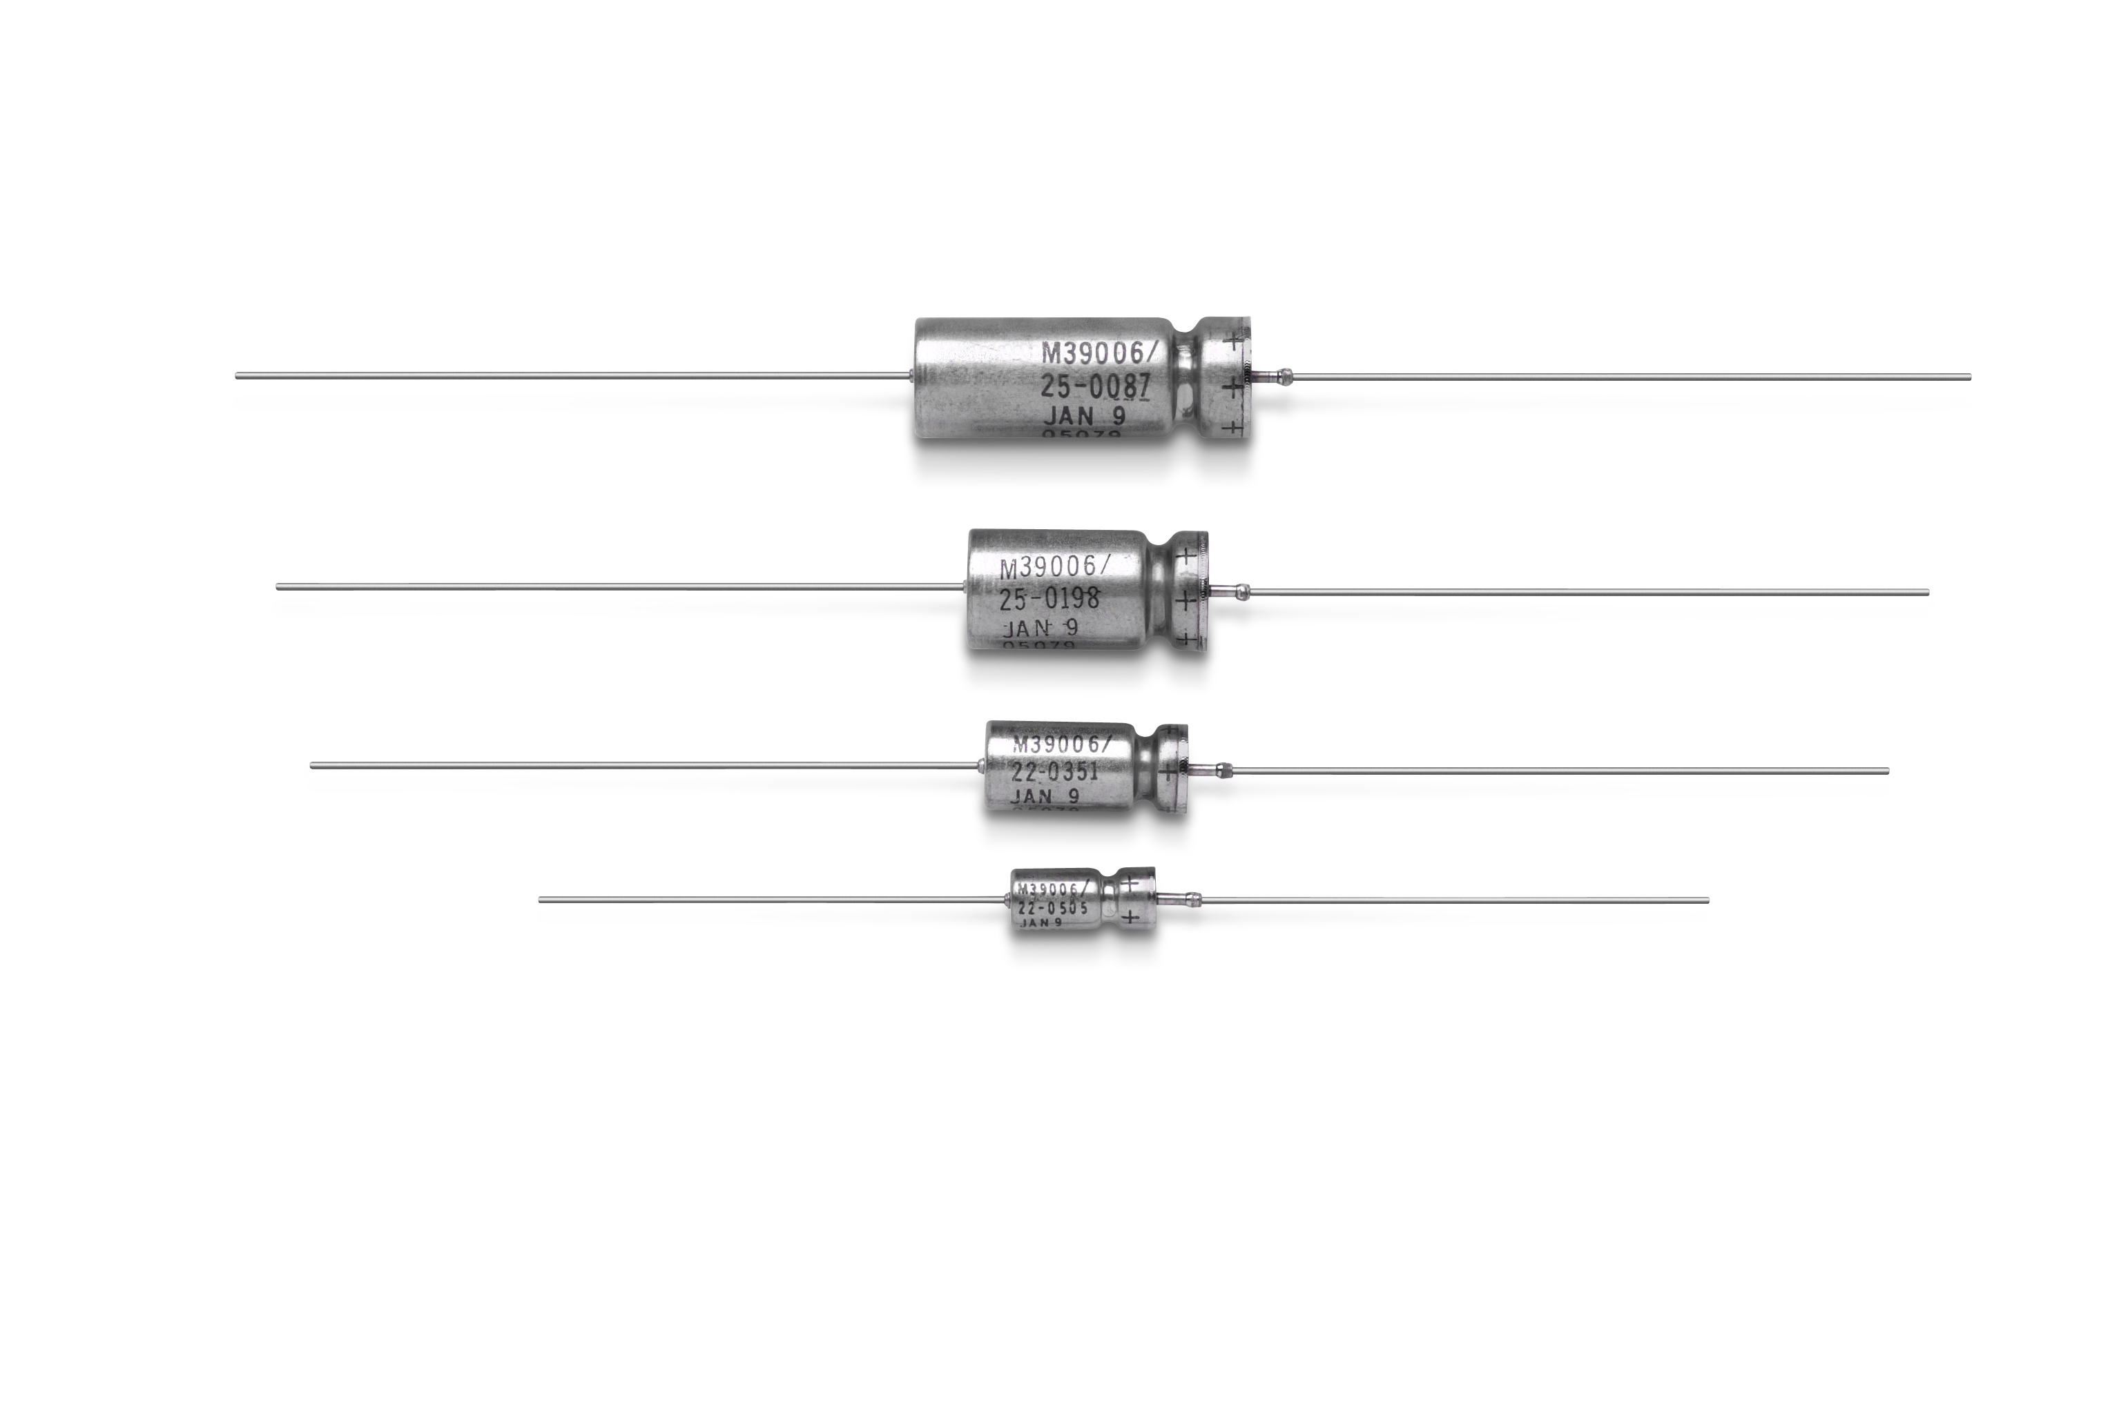
Vishay Legacy: Wet Tantalum: Tantalum Case, Axial Lead
Hermetic Seal, Tantalum / Glass Cover
MIL Approved: CLR79 (M39006/22) – Standard Values
EPPL Listed CLR81 (M39006/25) – Extended Range Values
CLR90 (M39006/30) – Low ESR, Standard Values
CLR91 (M39006/31) – Low ESR, Extended Range Values
DLA* Approved for Space: (Lot Performance Testing)
06013 [CLR79 (M39006/22) Values]
06014 [CLR81 (M39006/25) Values]
06015 [CLR90 (M39006/30) Values]
06016 [CLR91 (M39006/31) Values]
*DLA 06013-06016 specifications meet or exceed NASA/TP-2003-212242, Level 1 requirements
Operating Temperature: -55 °C to +200 °C
Capacitance Range: 1. 7µF to 2200 µF
Voltage Range: 6 Vdc to 125 Vdc
Case Sizes: T1, T2, T3, T4
Failure Rates: M (1 %), P (0.1 %), R (0.01 %)
Characteristic H: 80 g Sine Vibration, 54 g Random Vibration, 500 g Mechanical Shock
*Note: Two (2) manufacturing facilities: Dimona & Bennington
Notes:
Vishay is the leader in wet tantalum technology. With decades of experience, we have many products which are space qualified or military graded. As you can see, many different qualified families of products. Where the mil standard ends, DLA drawings begin with extended products from the same families. We provide lot performance testing as needed. Many of these products meet or exceed NASA requirements. Failure rates of M, P and R are available. H characteristic for shock and vibration also available

Slide 5
Surface-Mount “SMD” Wet Tantalum Capacitors
First Generation
Second Generation - M34 Series
Notes:
Brief slide to show where surface mount in wets has been.

Slide 6
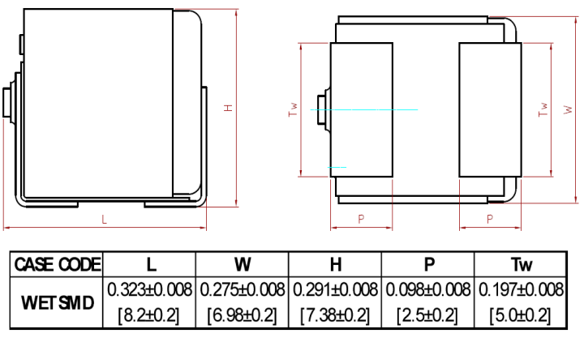
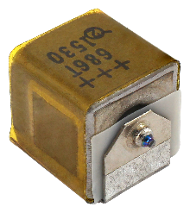
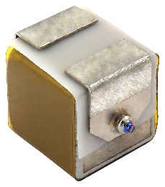
Third Generation
INDUSTRY FIRST!
Wet Tantalum: Surface-Mount
Small Size SMD , Hermetic Seal, Tantalum Case Capacitors
Commercial Series: T22
Military: DLA 19001
Space: DLA 20012
Capacitance Range: 10 µF to 110 µF
Voltage Range: 50 Vdc to 125 Vdc
Operating Temperature: -55 °C to +125 °C
Reverse Voltage to 3V
Shock – 500g: Mil-STD -202, Method 213, Condition D
Vibration – 80g peak: Mil-STD -202, Method 204, Condition H
Random – 53.8g Mil-STD -202, Method 214, Condition II-G
Case Size: C
Rating Available: 10 uF 125 V
15 uF 100 V
33 uF 75 V
68 uF 50 V
110 uF 50 V
US Patents: 09947479; 10600576
NASA paper on T22 at: https://nepp.nasa.gov/files/29192/NEPP-TR-2018-Teverovsky-T22-Capacitors-TN52048.pdf

Slide 7
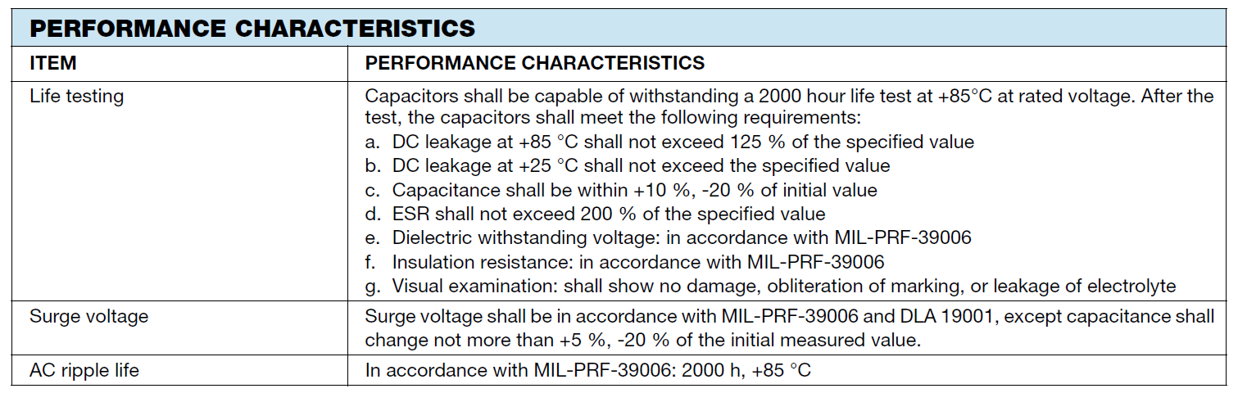
T22 Features
Operating temperature range -55 °C to +125 °C
0.9 W maximum power at 25 °C
100 % Sn (RoHS-compliant), capable of withstanding lead (Pb)-free reflow profile
Laser-welded, hermetically sealed all-tantalum rectangular package
EPD cathode for shock, vibration, and reverse voltage capabilities
500 g shock, 80 g sine, 53.8 g random
300 thermal cycles
3V reverse

Slide 8
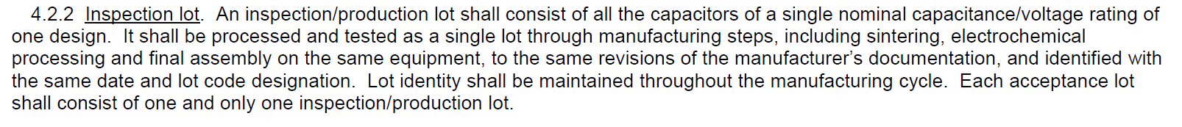
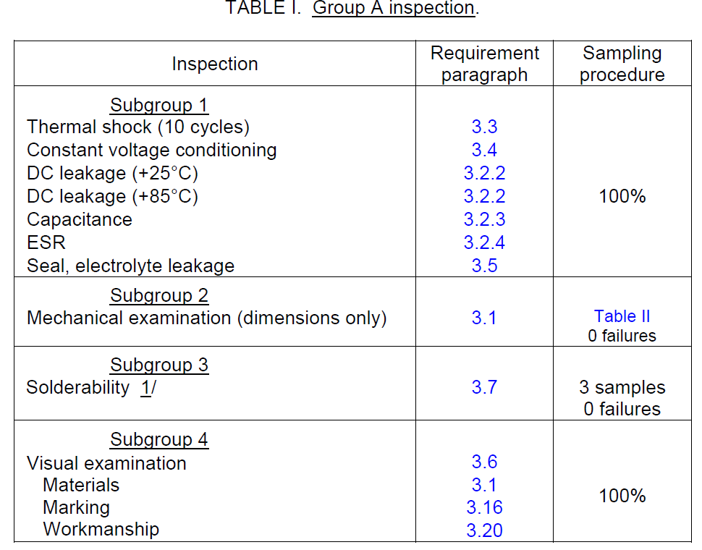
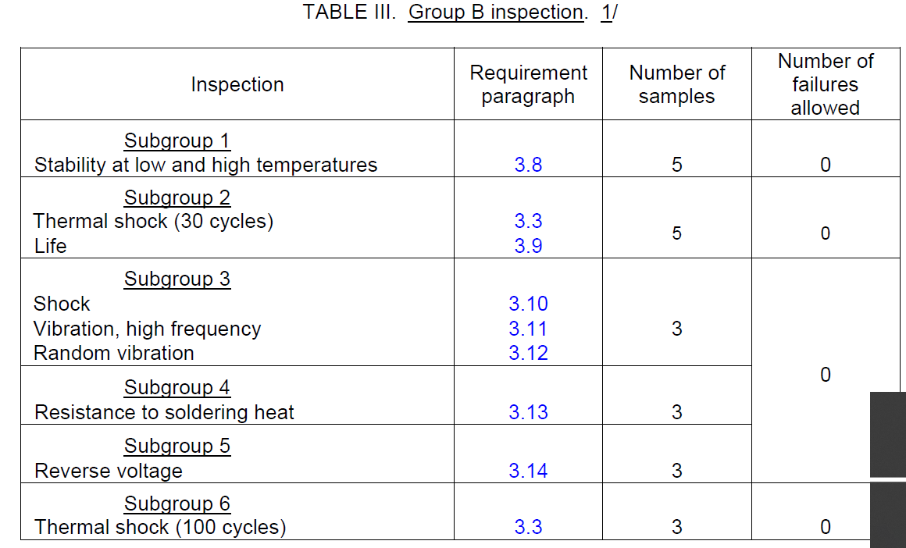
DLA 20012 (T22)

Slide 9
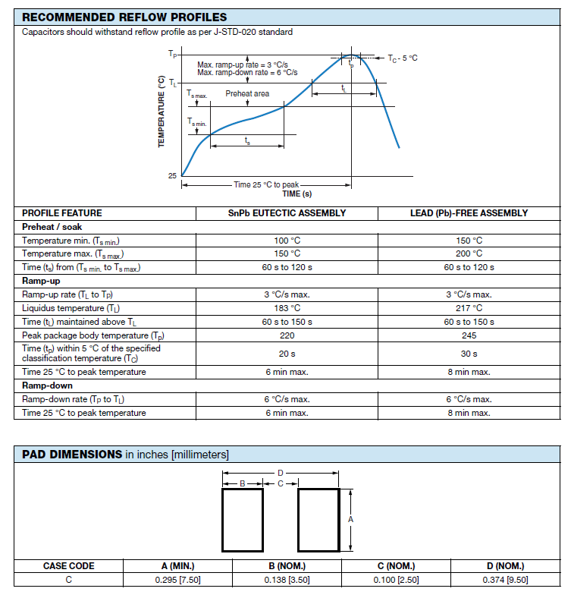
T22 Layout and Reflow

Slide 10
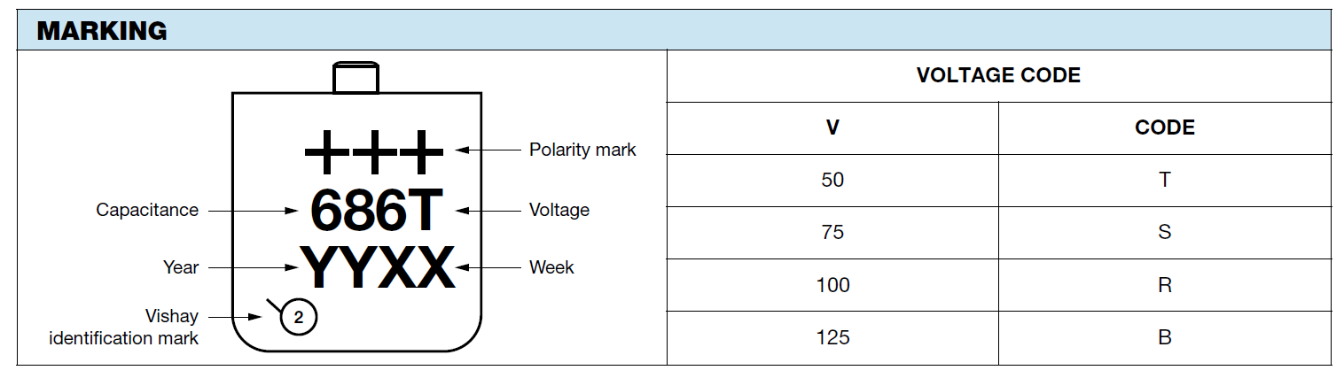
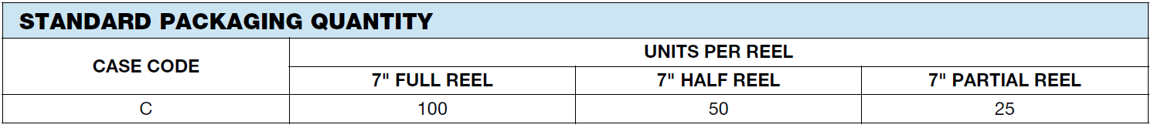
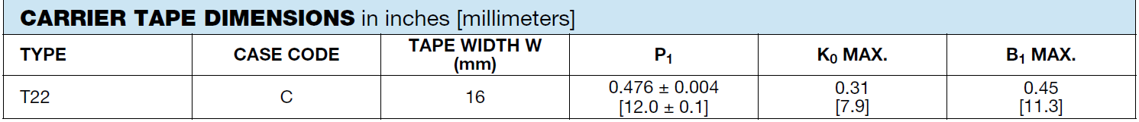
Identification

Slide 11
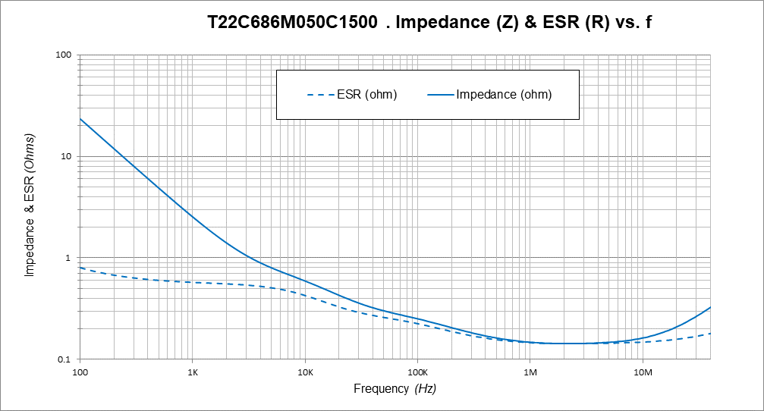
Typical Impedance and ESR Data

Slide 12
LIFE TEST 85 ºC RV, 2000 h
T22 10 µF – 125 V
Flags on graphs are spec limits

Slide 13
Typical Shock, Vibration & Random Data
Red lines are spec limits

Slide 14
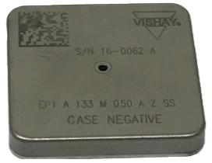
High Energy in Surface-Mount
EP1 Series
Hermetic Seal, Tantalum / Glass Cover
Commercial Series: EP1 Energy Pack
Military: DLA 20002
Operating Temperature: -55 °C to +125 °C
Capacitance Range: 1100 µF to 72 000 µF
Voltage Range: 25 Vdc to 125 Vdc
Case Sizes: A (available)
B (available)
C (available)
Failure Rate: Non-ER
50g Shock, 20g Vibration, 19.64g Random

Slide 15
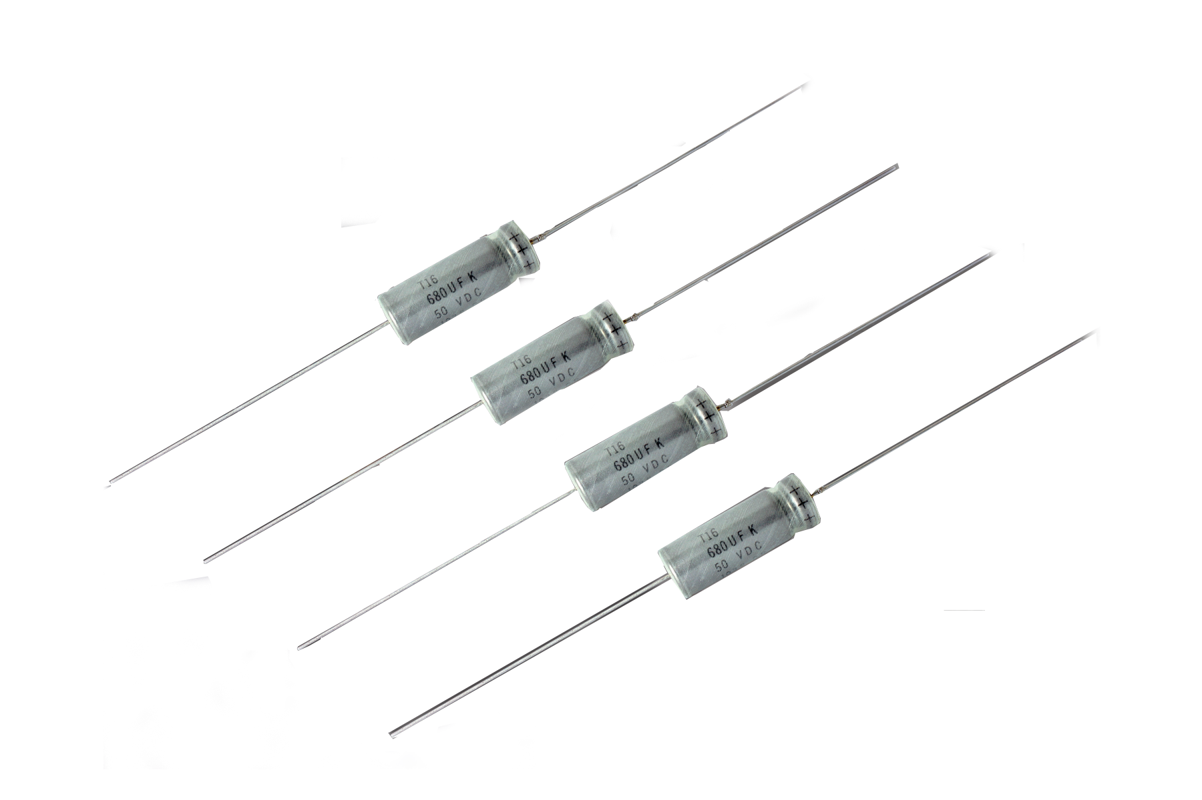
Wet Tantalum: Tantalum Case, Axial Lead
High Capacitance, “High Performance”
Hermetic Seal, Tantalum / Glass Cover
Commercial Series: T16 – Standard Range (Equal to ST)
Military: DLA 13017
Military: MIL-PRF-39006/33 (50 V – 100 V Ratings Qualified)
Operating Temperature: -55 °C to +125 °C
Capacitance Range: 10 µF to 1800 µF
Voltage Range: 25 Vdc to 125 Vdc
Case Sizes: T1,T2, T3, T4
Reliability level: H available
Hermetic Seal, Tantalum / Glass Cover
Commercial Series: T18 – Extended Range (Equal to STE)
Military: DLA 15005
Operating Temperature: -55 °C to +125 °C
Capacitance Range: 22 µF to 1200 µF
Voltage Range: 50 Vdc to 125Vdc
Case Sizes: T1, T2, T3, T4
Reliability level: H available
Enhanced Performance for Avionics and Space:
3.0 V Reverse Voltage
300 Thermal Cycles
54 g Random Vibration
80 g Sine Vibration
New Surface-Mount Tab Option Available as a Termination Alternative in Q3 2021
NEW
NEW

Slide 16
Conclusion
Wet tantalum capacitors provide:
High capacitance
High voltage
Low DC leakage
Long life
Mechanical robustness
Developments continue
Higher capacitance
New form factors such as high energy and surface-mount
High shock and vibration
Wet tantalum capacitors will continue to be an important segment of the tantalum capacitor market

Slide 18
www.vishay.com
THANK YOU!

