Slide 1
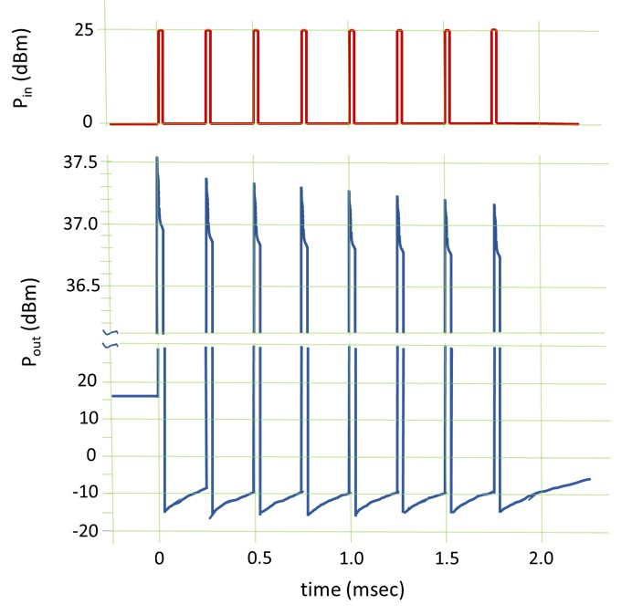
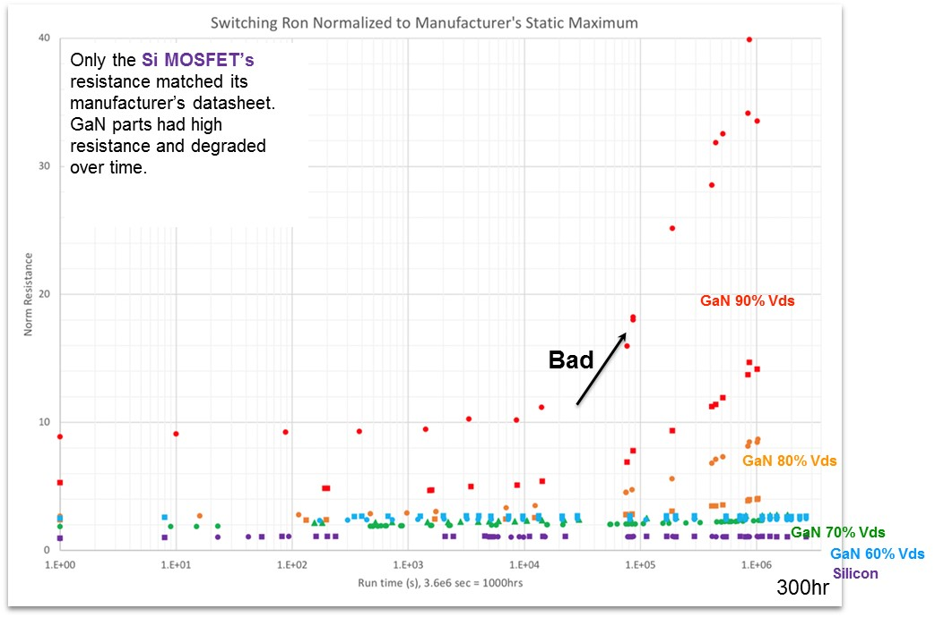
Role of charge trapping in GaN devices for a long hi-rel space mission
GaN RF/microwave devices ---
mainly useful as power amplifiers
traps manifest
“current collapse”
pulse-to-pulse instability
linear mode gain degradations much greater than in saturation
GaN power switch devices ---
mainly useful in switching power supplies
traps manifest as
changing dynamic drain-source on-resistance ΔR_{DS}(on)
R_{DS}(on) increases over time in a long mission
gradual loss of efficiency
“negative” effective activation energy effect
All of these effects are caused by temporary electron trapping
Have reliability metrics for GaN devices fallen short?
Is the space community adopting GaN too quickly?
CMSE 2021 panel discussion

