Slide 1

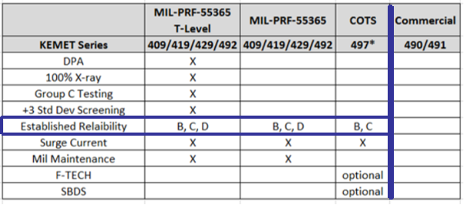
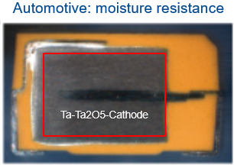
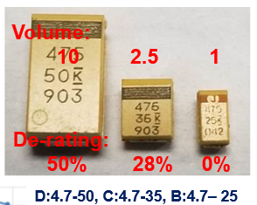
Automotive (commercial) vs. Hi-Rel Manufacturer Standpoint CMSE’19
Testing
Technology
De-rating

Slide 2
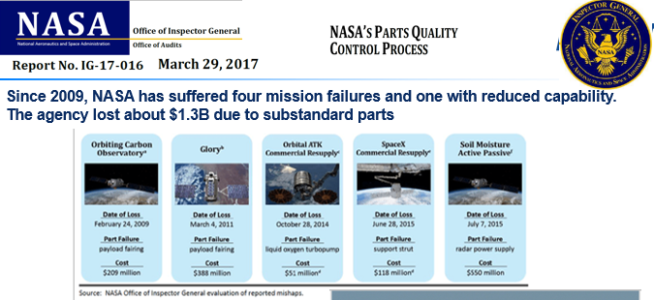
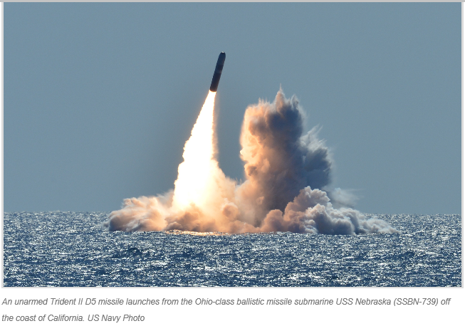
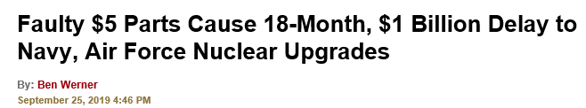
Substandard Parts:
NASA and MIL
https://news.usni.org/2019/09/25/faulty-5-parts-cause-18-month-1-billion-delay-to-navy-air-force-nuclear-upgrades

Slide 3
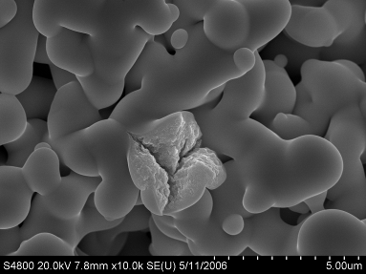
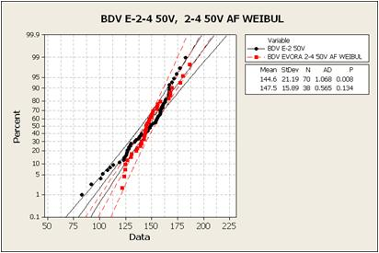
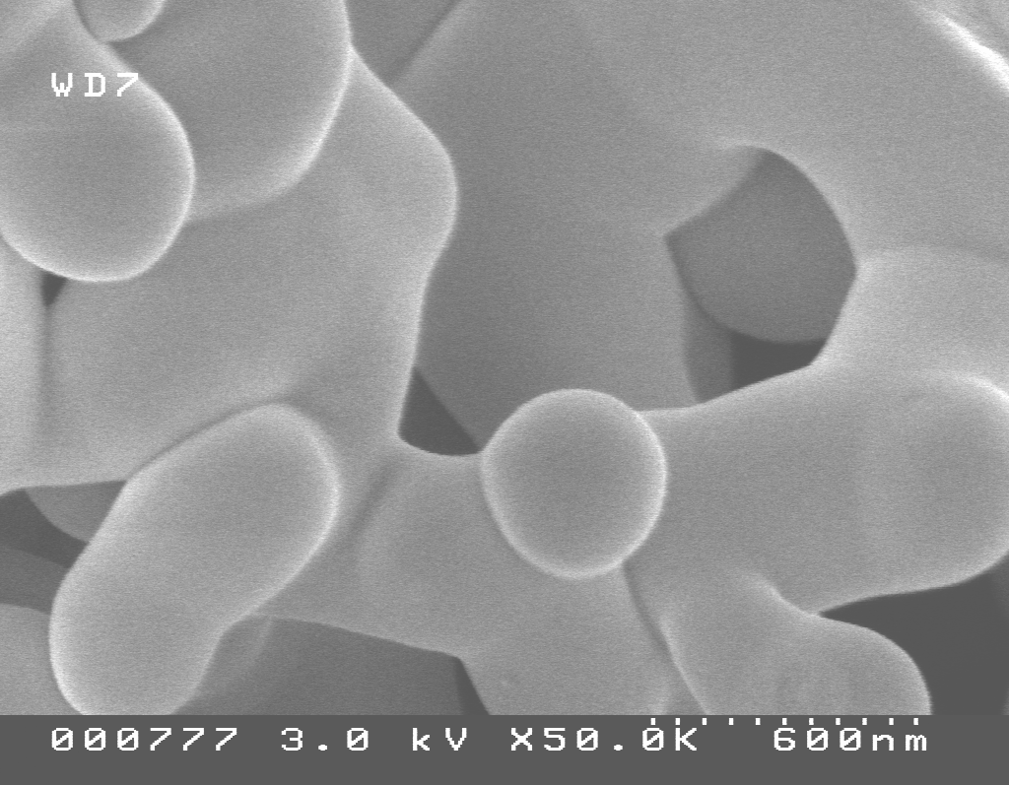
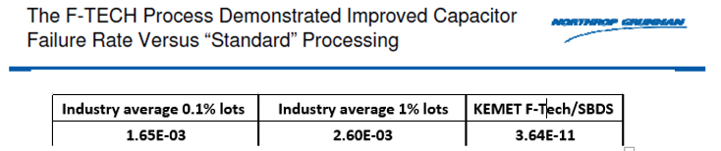
Hi-Rel COTS
Screening: Simulated Breakdown Screening (SBDS)
Materials and Processes:
Conventional vs. Flawless
Conventional
Conventional Technology
BDV Before/After SBDS
Before (black) has a tail
After (red) tail removed
Population (red) not affected
Flawless Technology
Customer Evaluation
CARTS 2014

